Slide 1
Student Organization Leadership 101
Officer Transitions
Holding Elections
Updating CampusLink and Accounting Signature Cards
Officer Transition/ Passing Information on to the New Officers

Slide 2
Holding Elections
Your organization’s constitution and/or bylaws will outline the procedures for elections.
Most organizations hold elections once per academic year.
You can hold in-person, private paper ballot, or online on CampusLink. Here’s How
However you choose to hold elections, be sure to record the ballots cast and the outcomes.
Vacant officer positions can be filled according to the constitution or bylaws.

Slide 3
Updating New Officer Information
Student Organizations are required to update their new officers’ names and contact information in CampusLink within 30 days after an election. HERE’S HOW
If your organization has an on-campus account (this is also called a “Fund” and is a number with a 1-99#### format) you will also need to request and then complete an Accounting Signature Card with the new President’s, Treasurer’s, and Advisor’s information and signature HERE.

Slide 4
Officer Transition/Passing Information on to the Incoming (New) Officers
Even if the new officers have been in the organization for years, their new role as officers will bring new challenges and responsibilities.
Officer transition is important to make sure that new officers have a firm foundation to continue to build the organization.
Officer transition includes passing any and all documents, resources, and materials on to the new officers.
It is ideal to do this in a lengthy formal meeting or an officer retreat where old officers can focus on providing information to the new officers and answering questions about their roles.

Slide 5
Tips for Officer Transition Meetings
Outgoing officers should all meet together because some roles or responsibilities overlap between positions.
Outgoing officers should collect and pass on ALL notes, documents, materials, resources and contact information to the new officers.
Important documents must be stored in the organization’s “Documents” page in CampusLink. HERE’S HOW
This guarantees that all current and future officers of the organization will have access to them instead of sharing them in a binder that will be lost or a personal drive with a personal password.

Slide 6
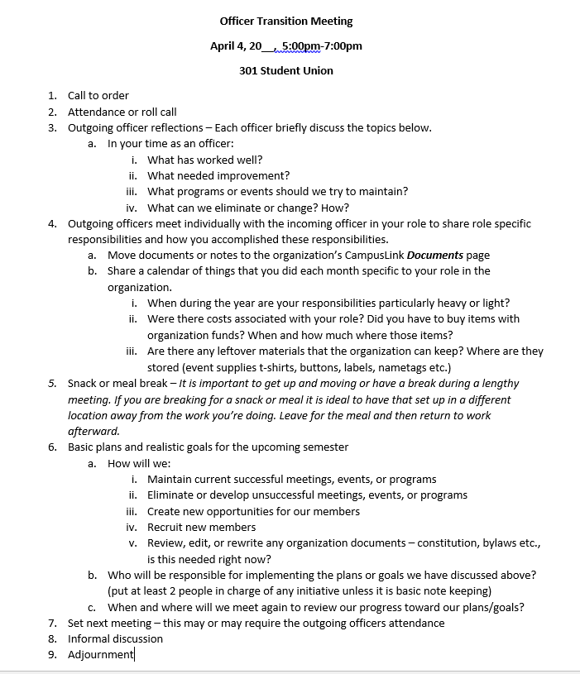
Tips for Officer Transition Meetings
Sample Agenda for an officer transition meeting.
This is a time for outgoing officers to reflect on their roles and offer advice, not tell the incoming officers what to do.
Offer the new officers a basic plan and ideas, but let them plan the next year on their own.

