Slide 1
Student Organization Leadership 101
Event Planning Basics
How to Create an Event on CampusLink
Reserving Meeting, Outdoor and Tabling Space
Ordering Food on Campus
Advertising Your Events/Free Graphic Design Services

Slide 2
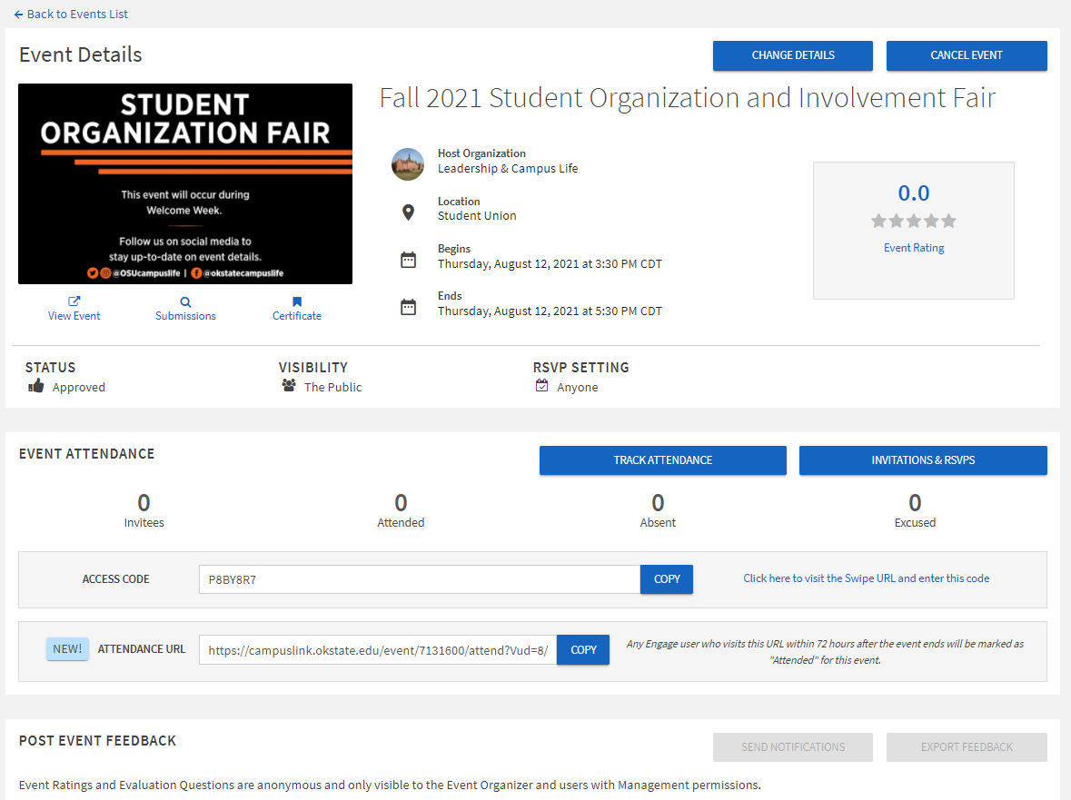
How to Create an Event on CampusLink
Anyone listed as an officer on their organization’s CampusLink Roster can create an event in CampusLink
Events on CampusLink can be set up to allow anyone on campus to attend or just organization members
View a short how-to video HERE

Slide 3
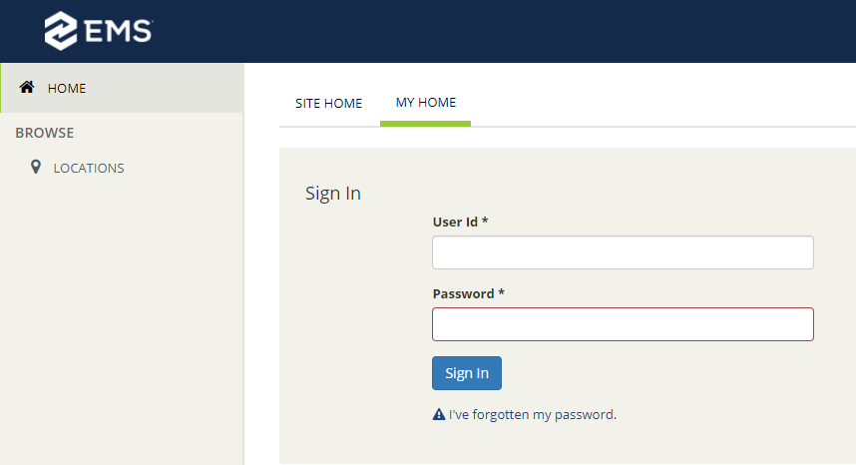
Reserving Meeting Space in the Student Union
Most organizations will reserve meeting space through the Student Union’s Meeting and Conference Services or the Registrar’s Classroom Reservations.
To reserve space in the Student Union, most lawns in the academic core area of campus, student group tailgate space, and tabling near Chi-O clock or the Classroom Building (CLB) area stop by 179 Student Union or visit meetings.okstate.edu and click Reserve a Space.
Login with your SHORT User Id and OKEY password

Slide 4
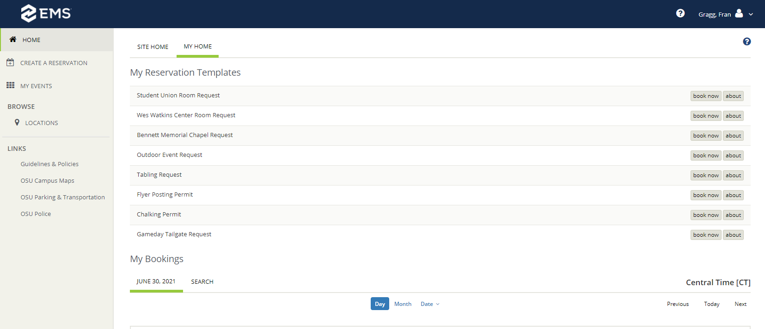
Reserving Meeting Space in the Student Union
You must book the space 2 weeks in advance.
Select the area you want to book and click “Book Now”.
Most rooms are free for student organizations to book unless the seating or layout is changed or the group does not use the room it has booked.

Slide 5
Reserving Classrooms
For student organizations non-profit organizational meetings: General University GU rooms can be requested by the top four officers (Pres., VP, Sec., Treas.) of an official student organization listed on CampusLink.
If you do not qualify to schedule a GU room based on the criteria above, there are several other excellent meeting resources in the Student Union.
To reserve a GU room, submit your request by completing the GU Room Request Form and submit it via email to gurooms@okstate.edu.
To reserve a GU classroom during pre-finals or finals week, submit a completed Pre-Finals/Finals Week Form via email to gurooms@okstate.edu, but please note that these requests are rarely approved.

Slide 6
Ordering Food

