Slide 1
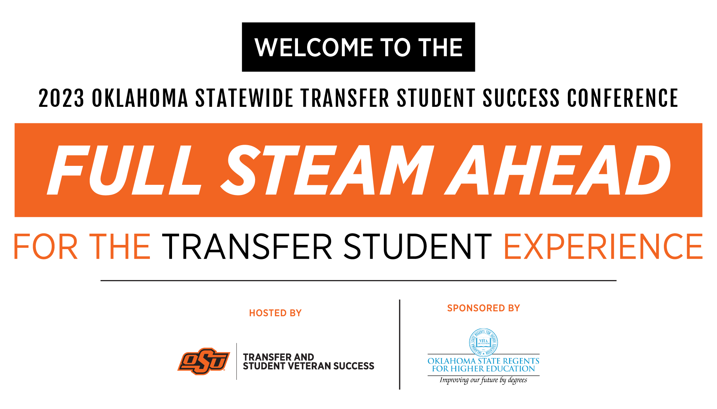

Slide 2

From “Stealth” to
“Full Steam Ahead!”
What role do Early Middle College High Schools (EMCHS) play in supporting students' successful transitions of “stealth students” to and through 4-year universities?

Slide 3
What is a “Stealth Transfer”?
Any student that transfers into a University/College that has accumulated enough college credit to be classified something other than what they would normally be without such credit.

Slide 4
Stealth Transfer continued:
STUDENT and Credits Earned | College credit earned and How | Incoming Classification | Academic Classification
High School Graduate with 32 hours | Earned through AP and IB | Freshman | Sophomore
High School Graduate with 45 hours | Earned through Dual Enrollment | Freshman | Sophomore
High School Graduate with Associates Degree and 79 hours | Earned at Early/Middle College High School (EMCHS) | Freshman | Junior
Second Semester College Transfer that earned an Associates Degree in High School with 92 hours | Earned Associates Degree at EMCHS with 77 hours. Earned 15 hours in 1st Semester of College | Should be 2nd Semester Freshman | Senior

Slide 5
Who am I and Why am I up Here?
Christopher D. McAdoo M.Ed.L.
1993-Northeastern State University- B.S. in Mathematics Education
2011-University of Central Oklahoma – Masters in Educational Leadership
Currently pursuing my PhD. in Educational Leadership and Policy Studies, PhD Higher Education
Principal of Santa Fe South Pathways Middle College

Slide 6
We are creating your problem.
Early College students earned an average of 23 college credits upon graduating from high school, and 88% enrolled in college in the immediate fall (AIR, 2009).
84% of Early College students enroll in postsecondary education, compared to 77% of traditional high school students (AIR, 2009).
Early College student population is growing.
  Pathways: 2014=13 students in 2023=70 students
  Oklahoma: 2014=1 EMCHS in 2023=15 EMCHS

Slide 7
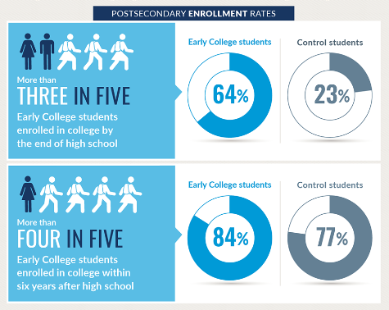
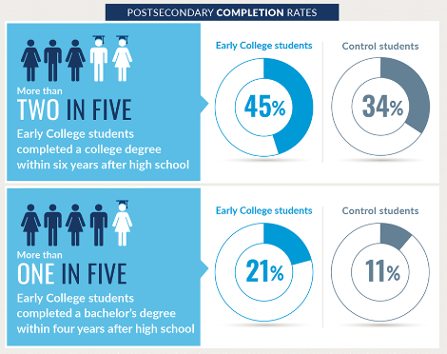
But it’s a GOOD problem.

Slide 8
Early/Middle College High School (EMCHS)
Middle College: A program focused on getting high school students college credit through dual/concurrent enrollment while still in high school.
Early College: A program, located on a college campus, focused on getting high school students an Associates Degree through dual/concurrent enrollment while still in high school.

Slide 9
Pathways Middle College High School
Founded in 2001 under the Oklahoma City Public Schools (OKCPS) umbrella as Pathways Middle College High School.
OKCPS closed school in 2014.
  Lack of growth
    71 students
    5 teachers
    4 classrooms
  Lack of success
    Average student – 13 hours of college credit
    1 Student earned an Associates Degree (by accident)

Slide 10
Santa Fe South Pathways Middle
Santa Fe South Pathways Middle College is a 4-year comprehensive high school located on the campus of Oklahoma City Community College (OCCC).
Re-opened under new name, with same teachers, vision, and mission.
  Growth
    20 teachers/staff
    330 students
    The entire 3rd floor of the OCCC campus
  Success
    Average student 56 hours of college credit
    212 students have earned and Associates Degree (intentional)

Slide 11

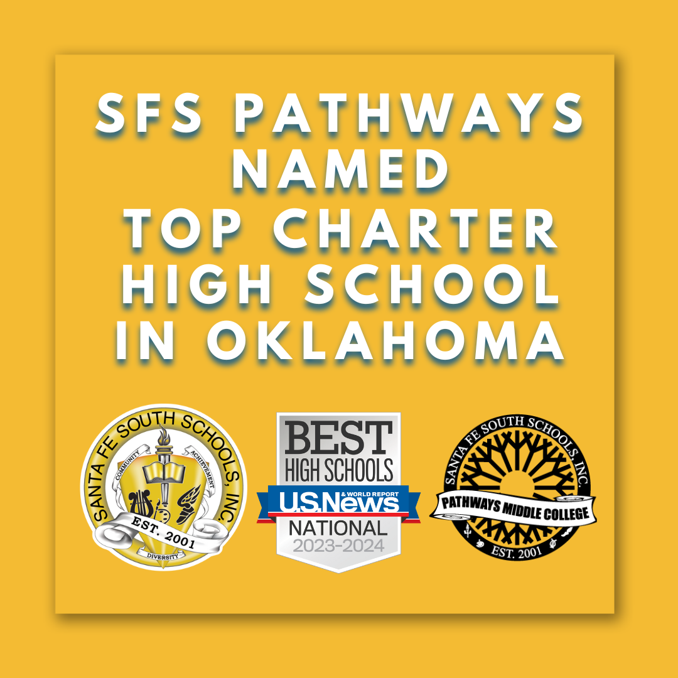

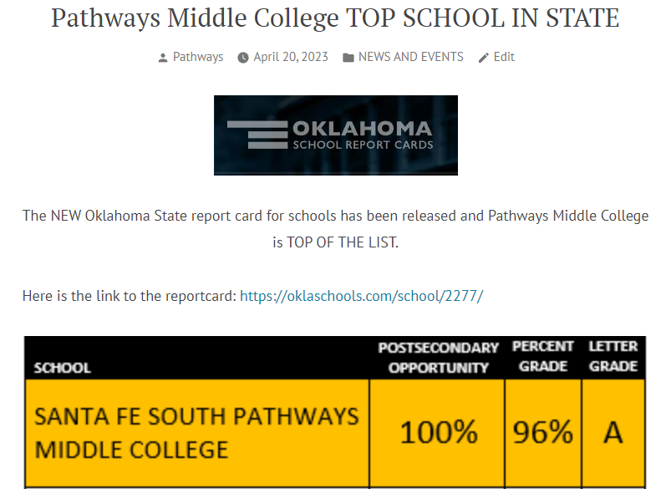
Santa Fe South Pathways Middle College

Slide 12

This is the environment that they are coming from.

Slide 13
Qualified VS. Prepared for College
Qualified
Prepared
Graduated from High School
Took the ACT and made a score that allows them to attend college
Have the GPA that allows them to attend college
Received scholarships to pay for college
Goes to classes without be forced to by a prescriptive schedule.
Studies outside of class to prepare for future class.
Manages time and priorities of college expectations
Sense of Direction, Curiosity, Purpose.

Slide 14
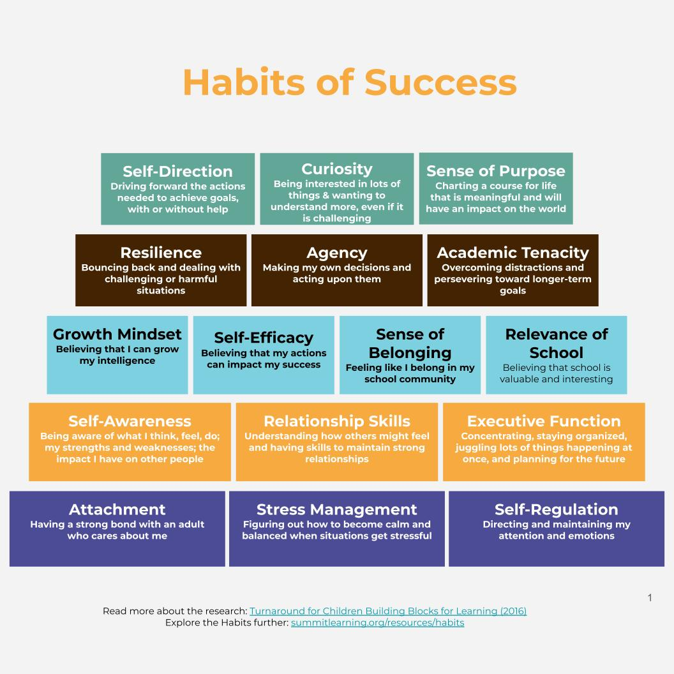
Comprehensive Support Services (CSS)
Dedicated counselor(s) and college liaisons
Faculty members who serve as counselors or mentors
Seminars for students enrolled in college classes
Tutoring
Regular communication with parents
Established map of all services available to students and families

Slide 15
What Challenges do they face after they transfer?
“Adulting 101”
  How to be a “College Freshman” (in the wild)
  How to live on their own
  How to handle freedom from parents
  How to handle being the youngest students in their classes
  How to realize that they don’t HAVE to graduate in 2 years
  How to leverage a scholarship to maybe start a Masters.

Slide 16
What is Less Challenging?
They have proven they can do college classes.
They understand the rigor expected from them.
They have practice “doing” college.
They know how to study.
They know how to ask for help.
They know how to look at RATE MY PROFESSOR.
The financial burden of completing college.

Slide 17
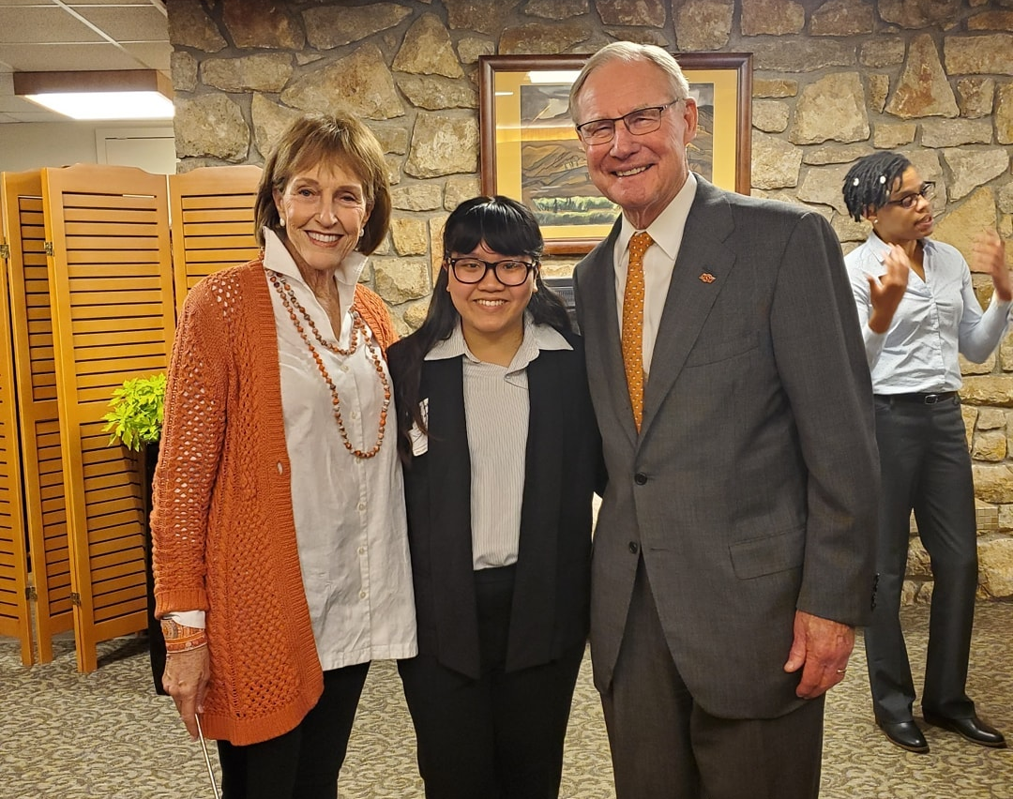
Tinh Dang
Graduated 2018 High School
Graduated 2018 with Associates in Diversified Studies 66 credit hours
Transferred into Oklahoma State University 2018-2020
Member of the RISE Program
Lived in the Dorms
Graduated with BS. In Elementary Education 2020
Returned to Community to be 4th grade teacher.

Slide 18

Harrison Langston
Graduated 2016 High School
Sports Writer, Entertainment Reviewer, Assistant Webmaster for The Pioneer the college Newspaper.
Graduated 2016 with Associates in Diversified Studies 62 credit hours
Transferred into Oklahoma State University 2016-2019
Lived in the Dorms
Graduated with BA Sociology Degree 2019
Social Service Specialist for the Oklahoma Department of Human Services.

Slide 19
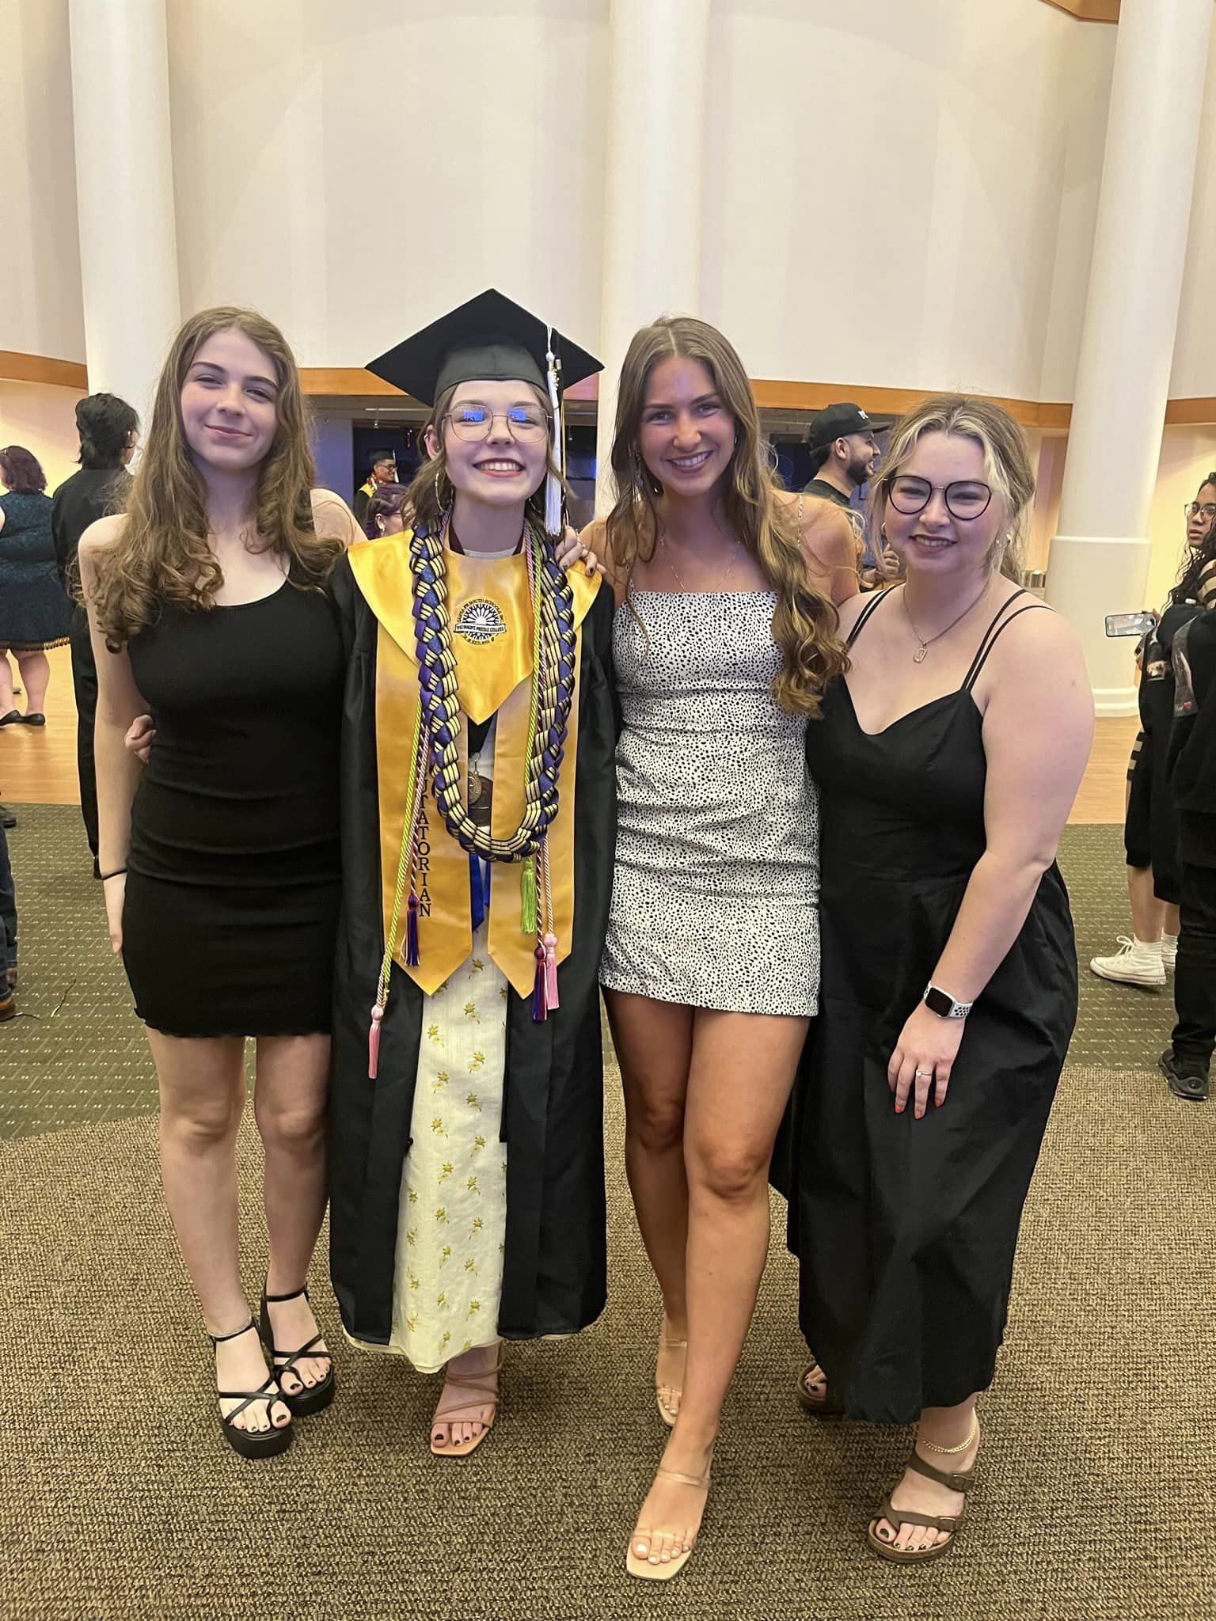
Madisyn McAdoo
Graduated 2023 High School
Graduated 2023 with Associates in Diversified Studies 79 credit hours
Accepted to Berkley School of Music in Boston- Would not transfer any credits.
Transferred into University of Central Oklahoma 2023-
Lives at home
Pursuing a dental Degree has already completed all requirements for Dental School.
This is a SHAMELESS plug to showcase my 4 daughters.
YES, THIS IS PATHETIC!!

Slide 20
What do “Stealth Students” need?
“Adulting 101”
  Treated like a “College Freshman” because that is what they are. ALL BENEFITS!
  A true sense of belonging.
  Learn how to be a “College Freshman” (in the wild)
  Learn how to live on their own
  Learn how to handle freedom from parents
  Learn how to handle being the youngest student in their classes
  Learn how to handle the realization that they don’t HAVE to graduate in 2 years
  Learn how leverage a scholarship to maybe start a Masters.
  LOVE AND SUPPORT!

Slide 21
Questions?

