Slide 2
Supporting Transfer Students through Institutional Collaboration
Dr. Laura Latta - Tulsa Higher Education Consortium
Dr. Sarah Wyatt- Tulsa Higher Education Consortium
Dr. Brandon Miller- Tulsa Community College

Slide 3
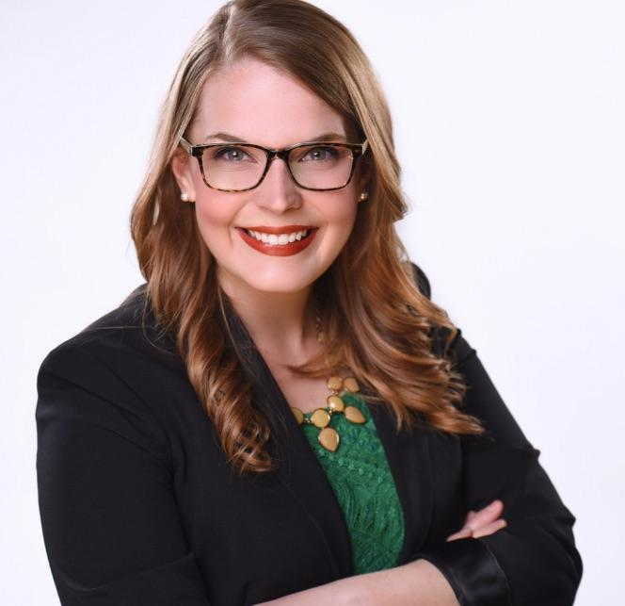
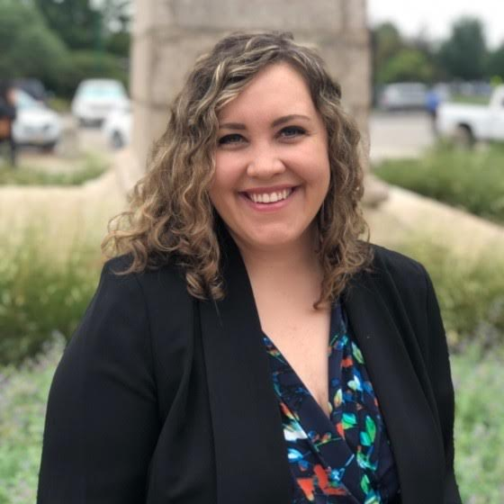
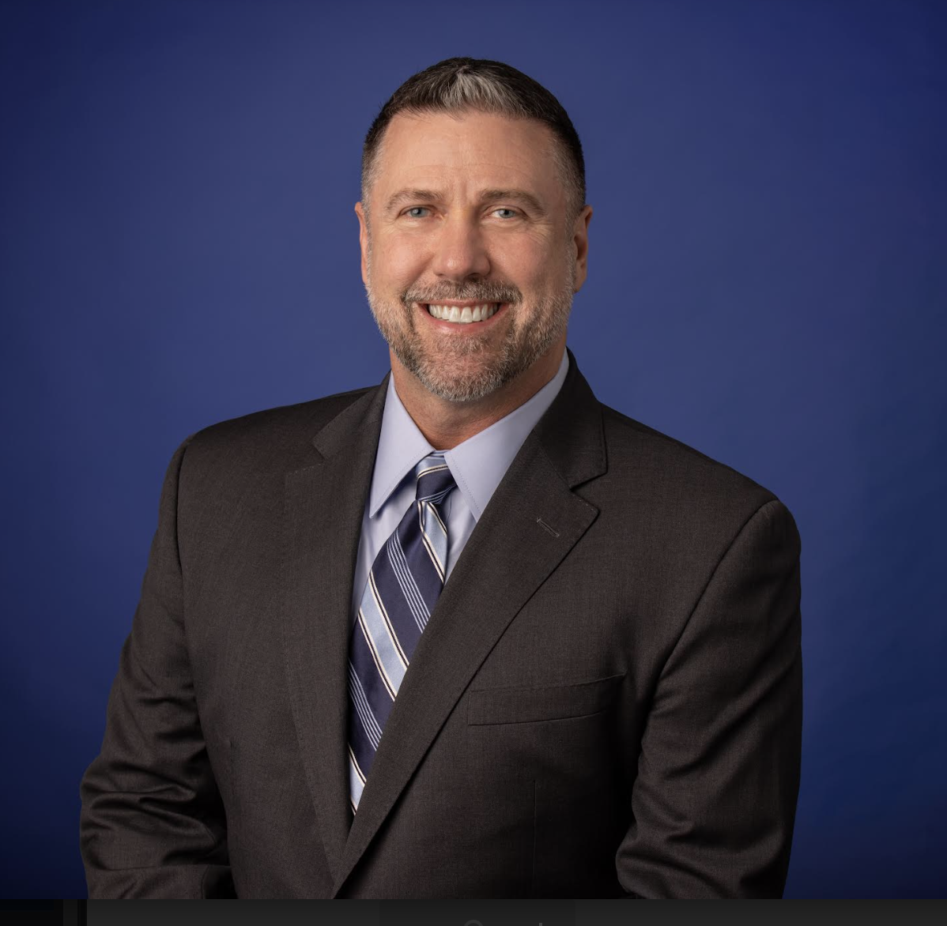
Presenters
Laura Latta, Ph.D.
Executive Director
Tulsa Higher Education Consortium
Sarah Wyatt, Ed.D.
Director of Strategy & Operations
Tulsa Higher Education Consortium
Brandon Miller, Ed.D.
Director of University Transfer
Tulsa Community College
Notes:
Supporting Transfer Students through Institutional Collaboration
In this session, presenters will share about the value of cross-institutional and cross-sector collaboration in support of transfer students. Through the facilitation of ten Communities of Practice and shared endeavors across the region, THE Consortium works to support eight colleges and thousands of students in the northeast Oklahoma region. The presentation will focus primarily on the startup, facilitation, and shared initiatives of communities of practice, a model that can be replicated in any setting where multiple institutions collaborate. Attendees will be invited to share ideas for possible shared endeavors and brainstorm plans to collaborate with other institutions in meaningful and generative ways.

Slide 4
Tulsa Higher Education Consortium Institutions
Notes:
THE Consortium’s origin
Tulsa MSA Population: 1,004,145*
Tulsa MSA Citizens 15+ years old: 795,634
51% are age 18-24⟊
49% are older than 25
-Students have diverse options
-Civic, philanthropic, and
37%- The National College Student transfer rate in 2019-2020
47% TCC students went on to attend THE Consortium institutions in 2021
62% TCC students enrolled in university transfer programs ain AY 22-23

Slide 5
Tulsa Higher Education Consortium Affiliates
Notes:
Supporting students is a city-wide initiative
Buy in from civic, philanthropic, business groups is key

Slide 6
Evolution of Collaboration
Leadership from 7 Tulsa higher education institutions, business and industry, city, and non-profit sectors formed a formal task force to develop the plan for a consortium structure to continue and expand on the Tulsa Transfer Project work.
July 2018-
Tulsa Transfer Project
January 2020- Tulsa Higher Education Task Force
July 2021: Tulsa Higher Education Consortium Launch
Notes:
Pam

Slide 7
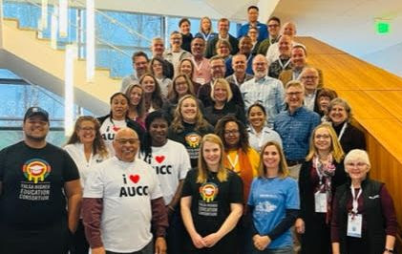
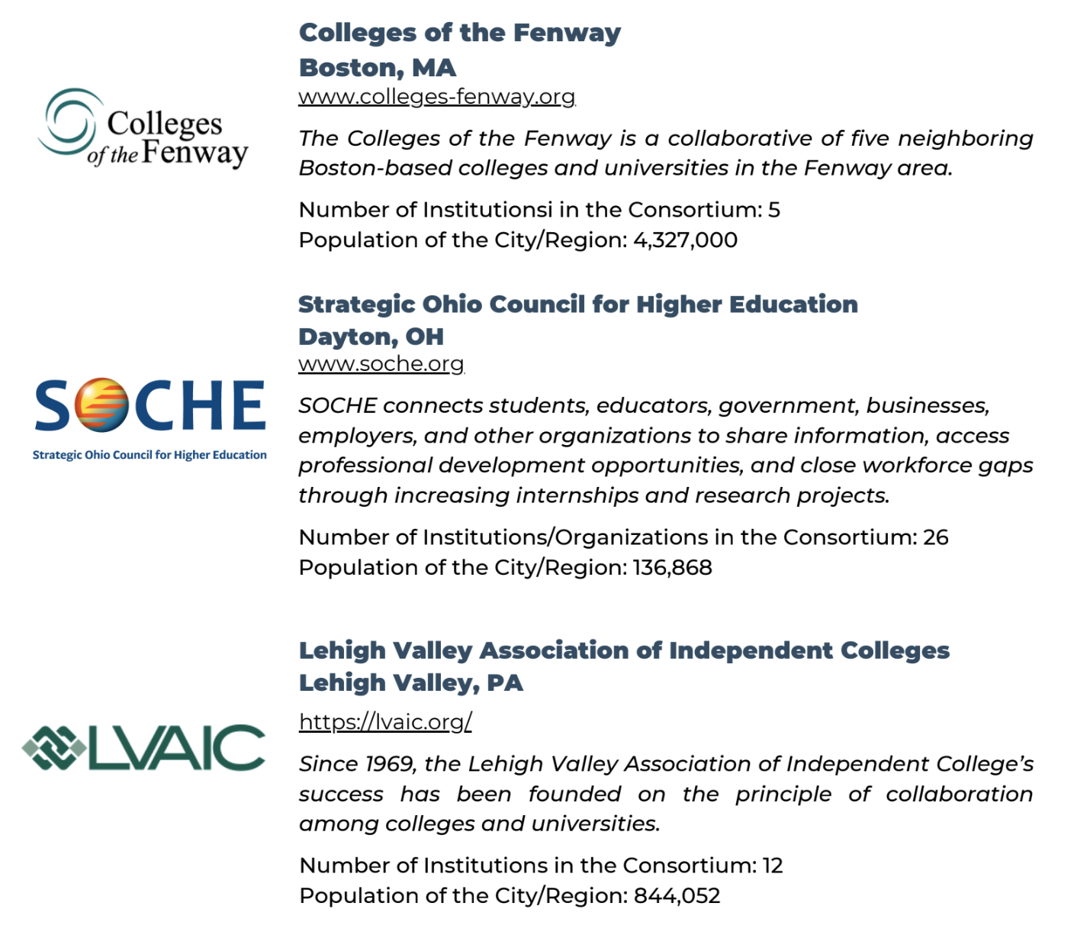
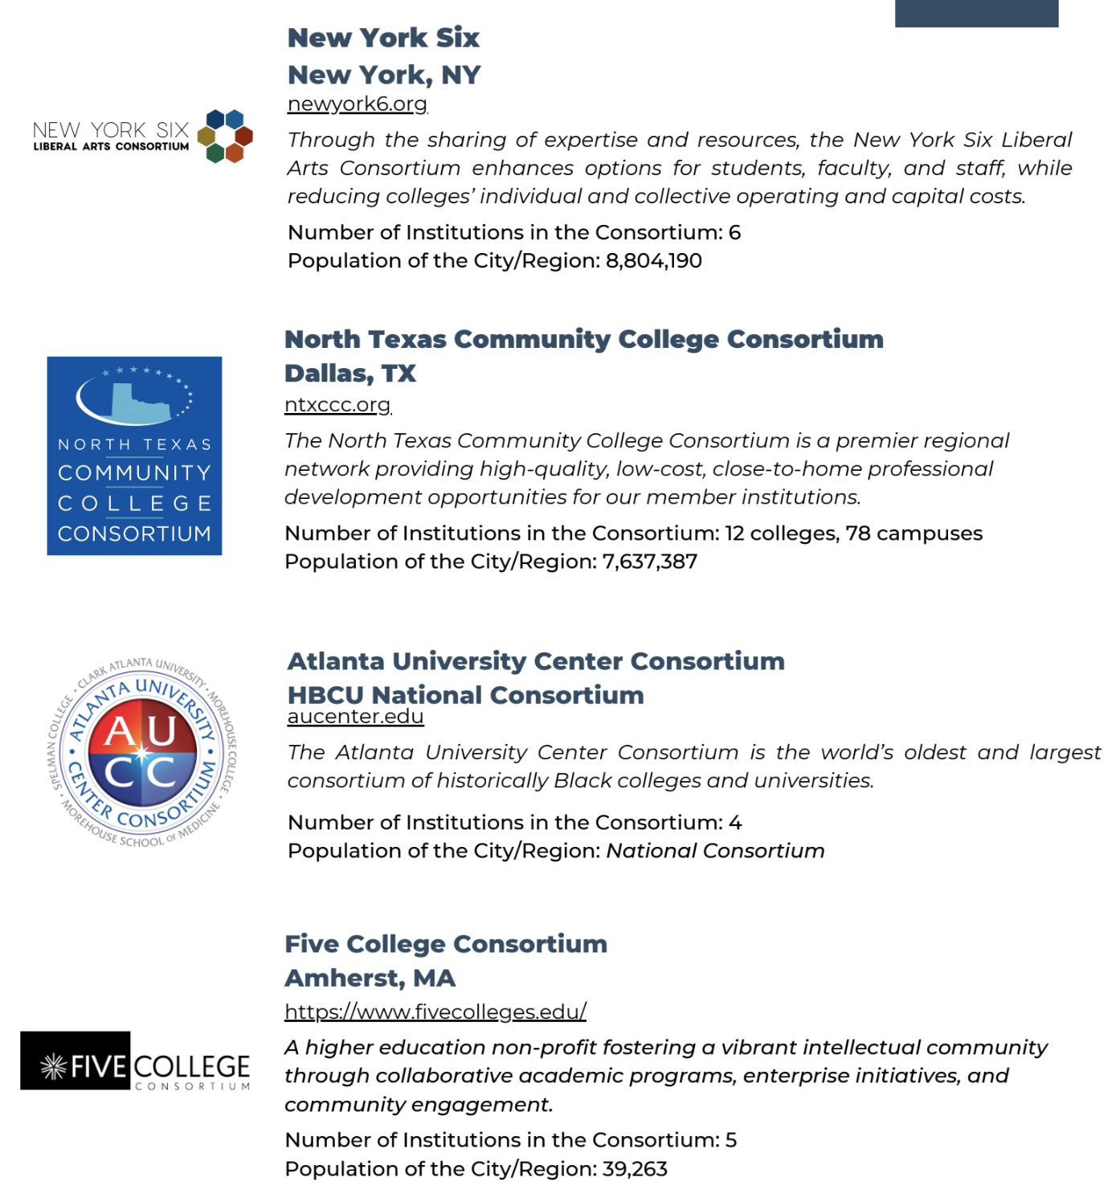
Peer Consortia
Notes:
Laura
Benefits of a Consortium Model

Slide 8
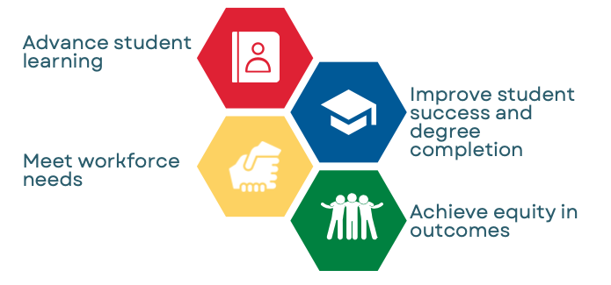
THE Consortium’s Mission
Notes:
Laura

Slide 9
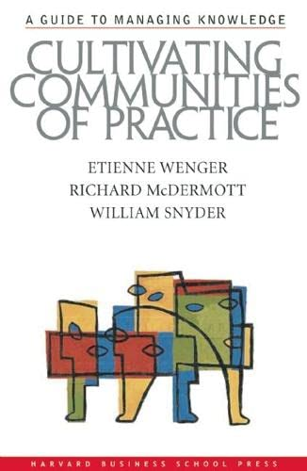
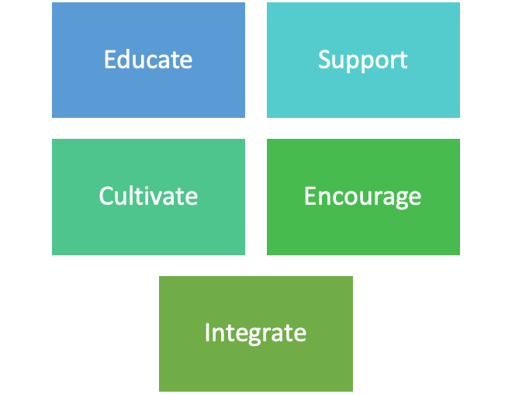
Benefits of a Community of Practice
Source: https://www.communityofpractice.ca/background/why-communities-of-practice-are-important/
Notes:
Laura
Educate by collecting and sharing information related to questions and issues of practice
Support by organizing interactions and collaboration among members
Cultivate by assisting groups to start and sustain their learning
Encourage by promoting the work of members through discussion and sharing
Integrate by encouraging members to use their new knowledge for real change in their own work.

Slide 10
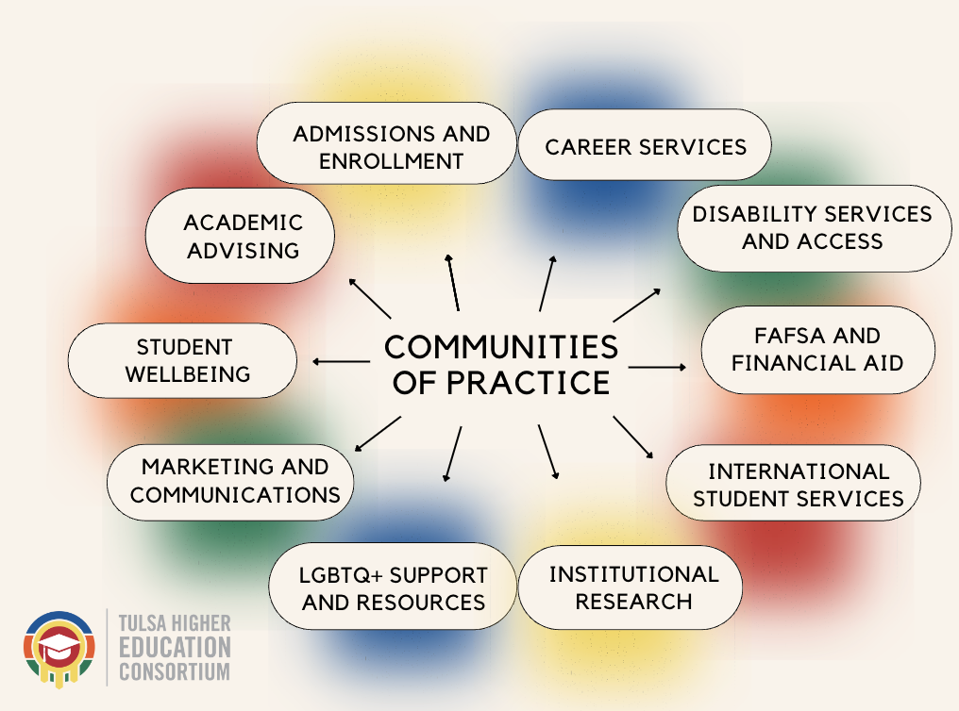
Communities of Practice
What are they?
A group of people who share, A similar role, a common set of challenges, or an interest in a topic and who collaborate to fulfill shared goals.
Who are they?
They're you! Professionals from all levels representing the eight Consortium member-institutions.
How are they created?
Strategically or Organically
Notes:
Sarah

Slide 11
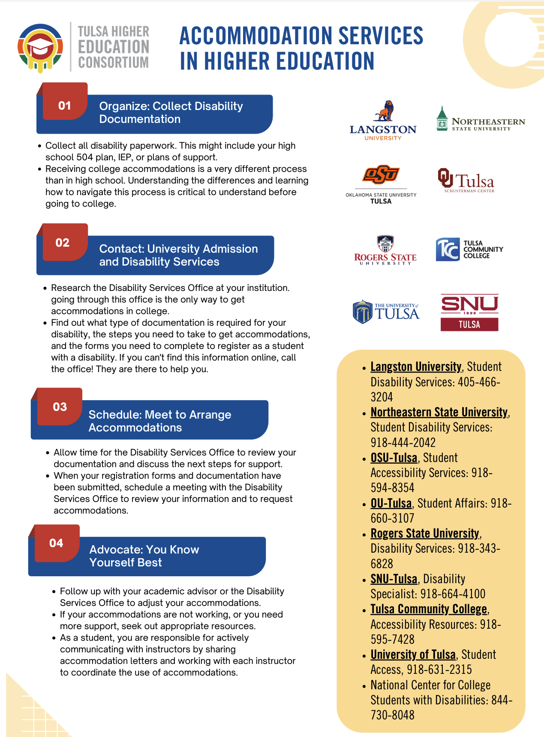
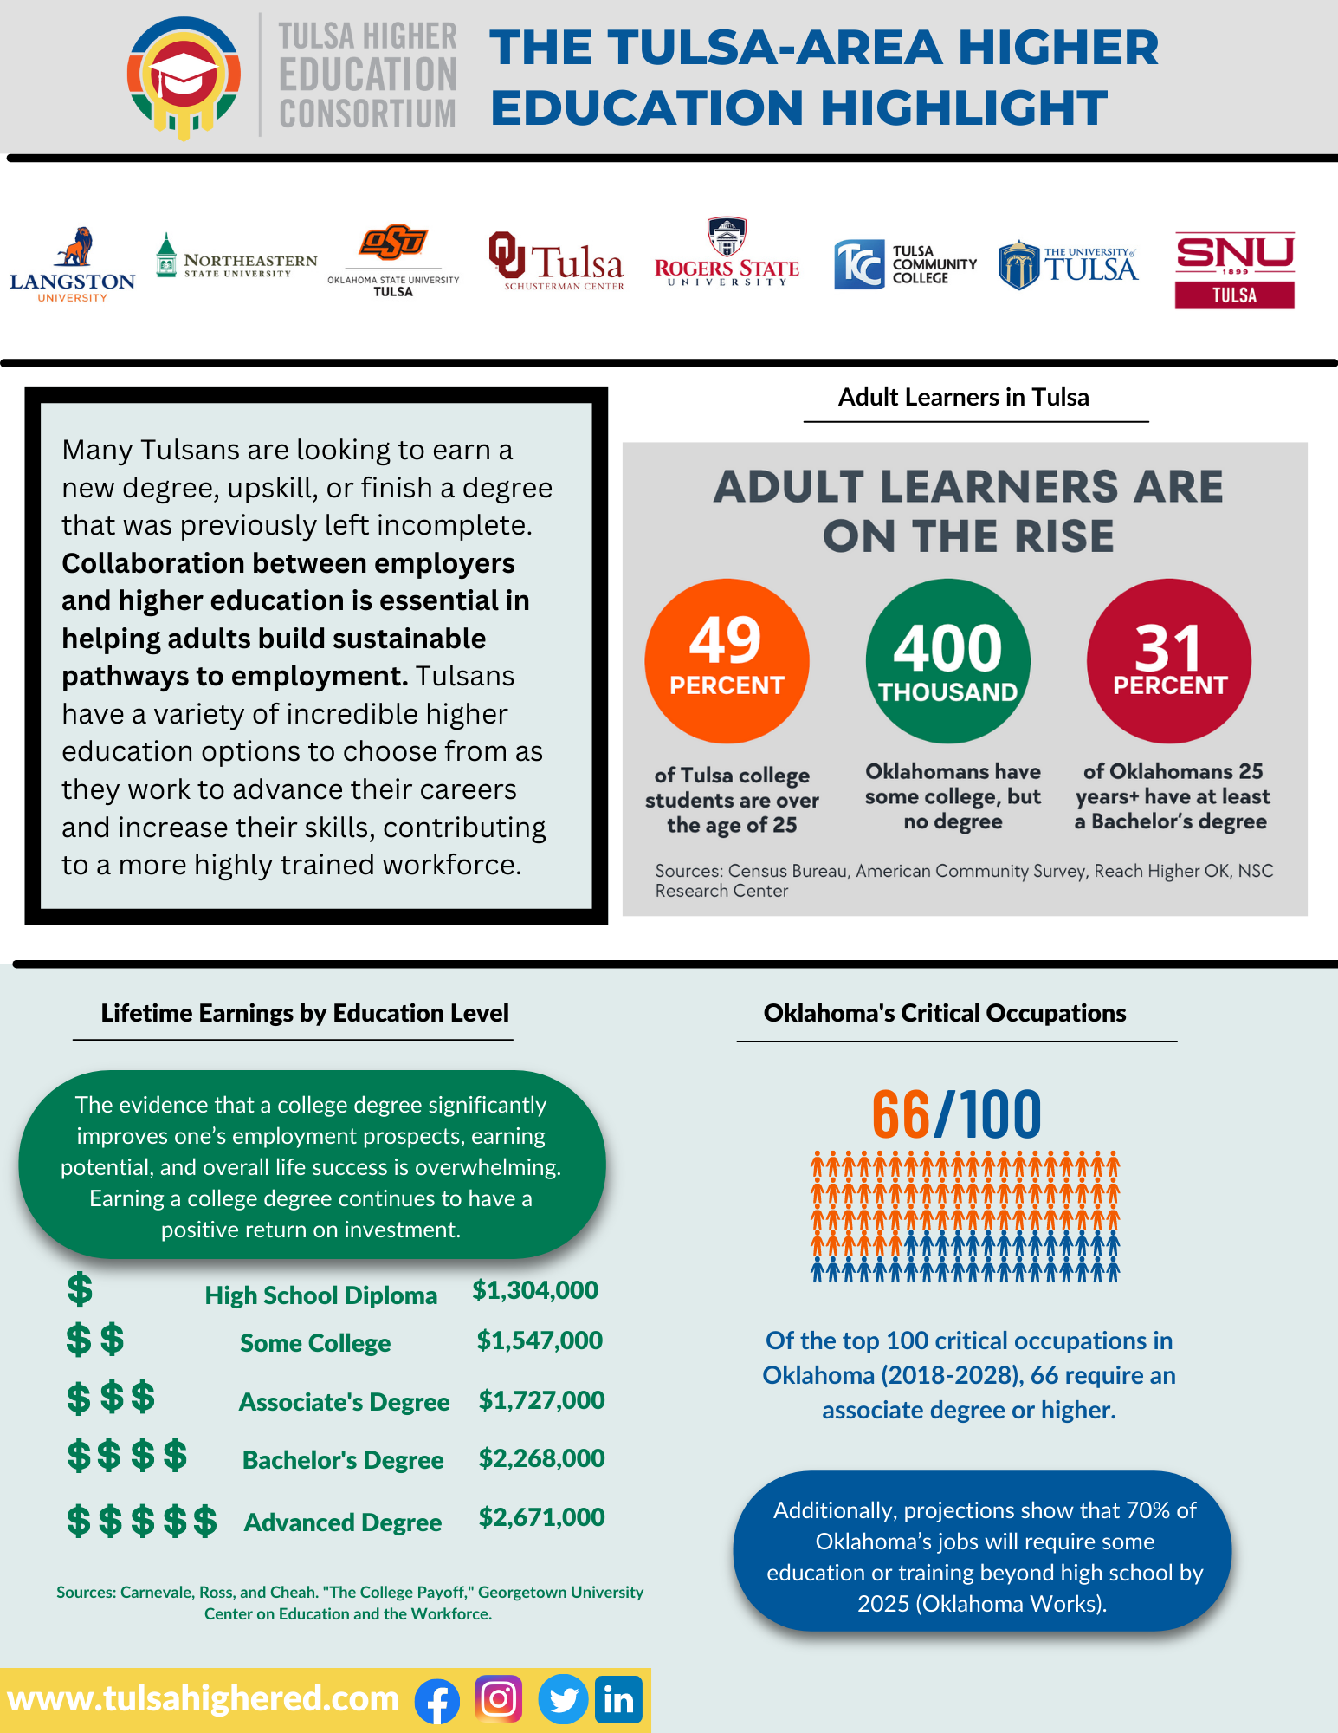
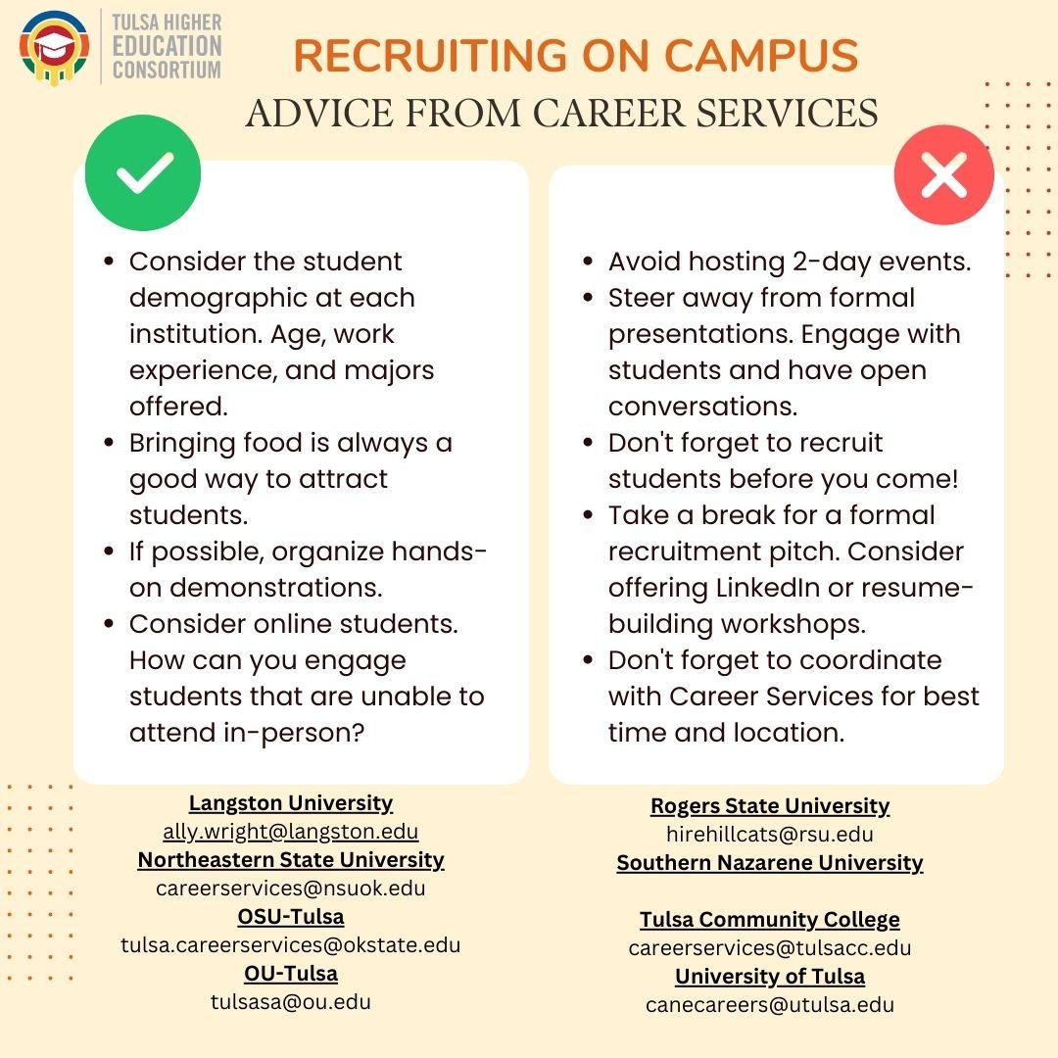
Communities of Practice Resources
Notes:
Sarah

Slide 12
Past Experiences + Benefits of Communities of Practice
North Texas Transfer Student Success Consortium
Pre-formalization of NISTS
Notes:
Brandon

Slide 13
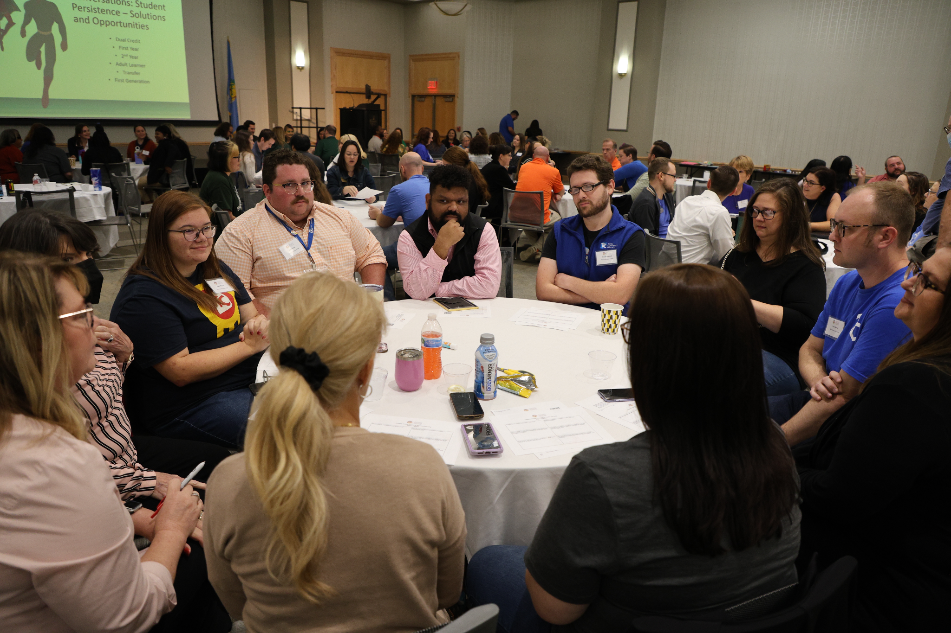
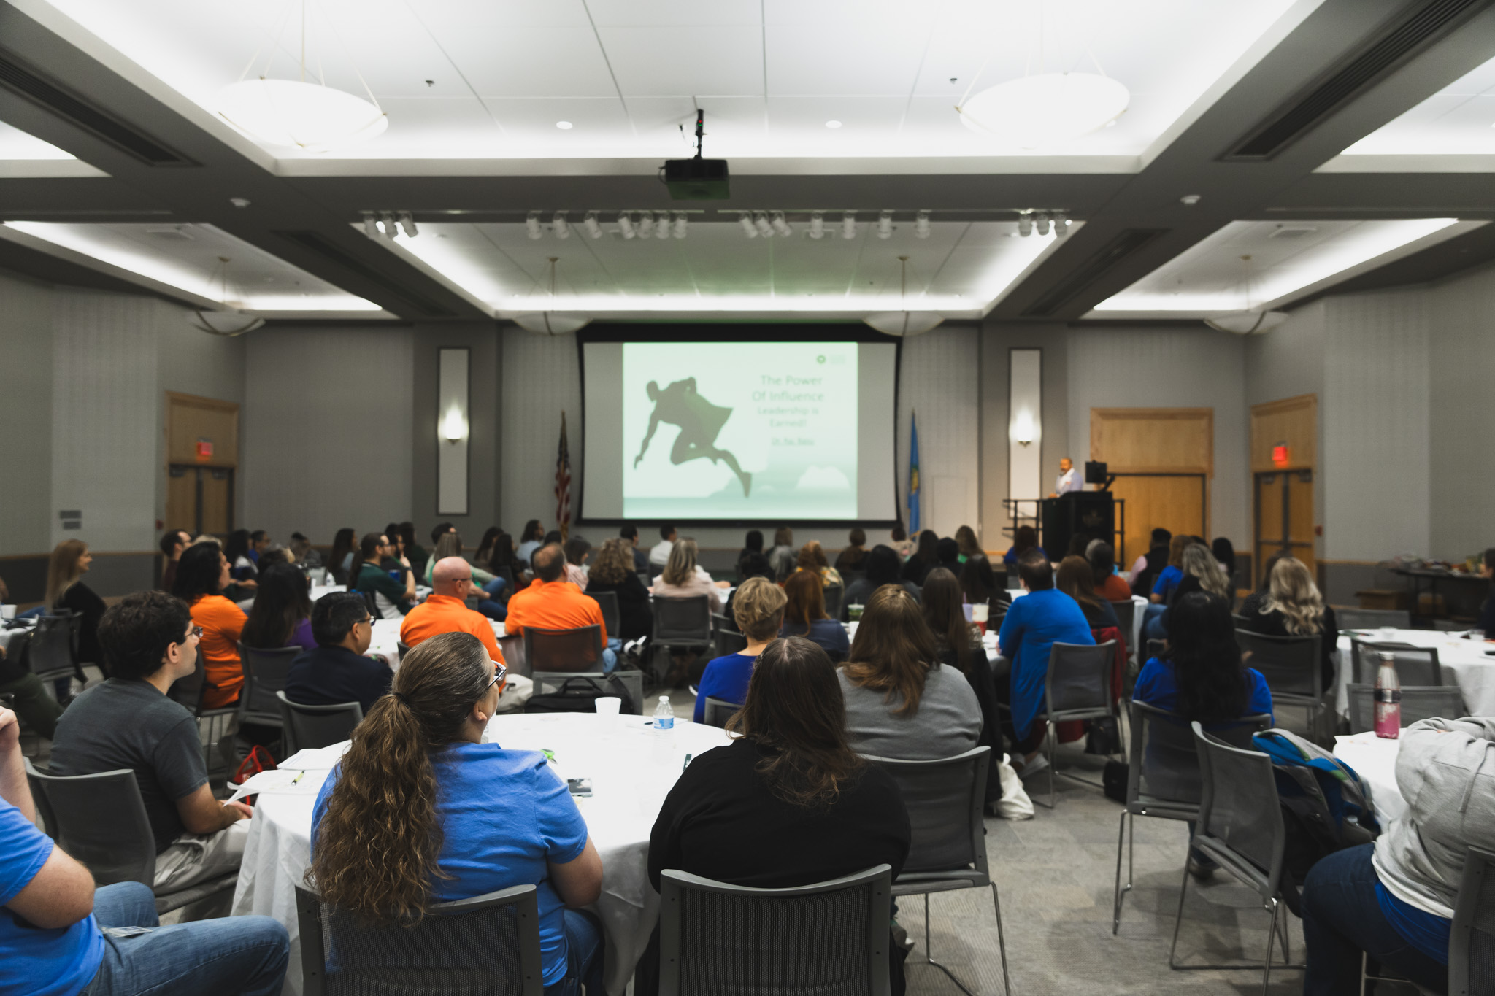
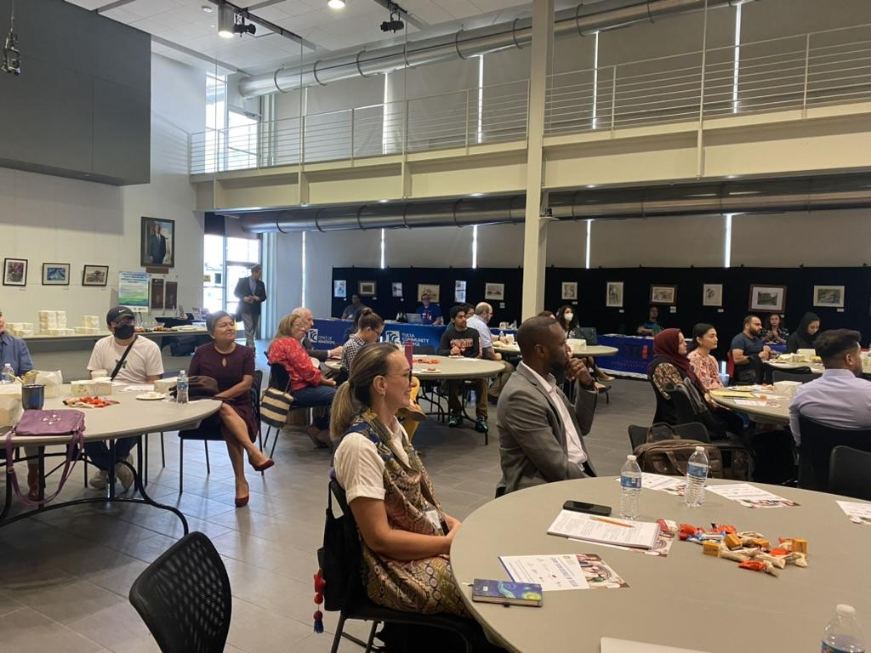
Lessons Learned from THE Consortium’s CoPs
Notes:
Brandon

Slide 14
Transferability of Consortium Model
Notes:
Brandon
Transferability in Other Contexts

Slide 15
Ready to start your own? - 5 Quick Steps
Identify a leader (both a facilitator and logistics)
Begin creating an invitation list. Think about higher education partners and special guests
Create an agenda template and meetings minute folder
Identify possible goals for the group. What are challenge areas?
Determine appropriate meeting frequency for the group.
Notes:
Sarah

Slide 16
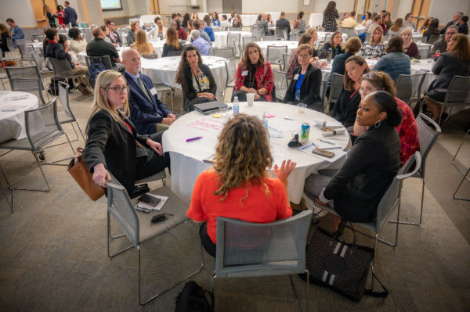
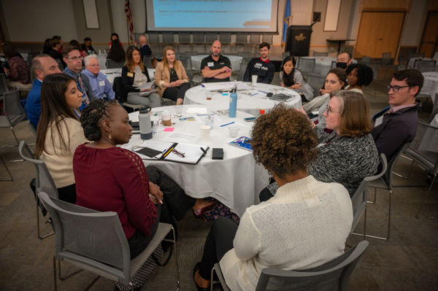
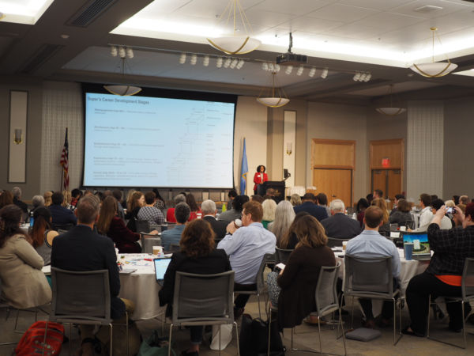
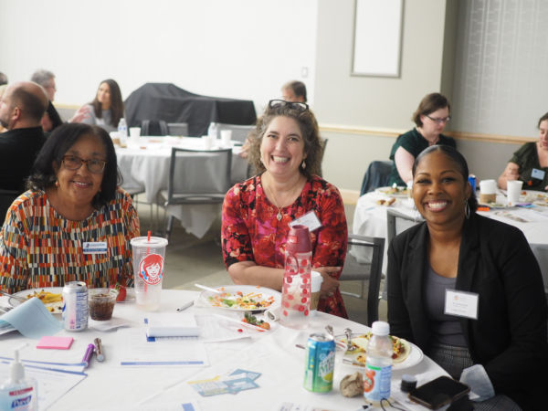
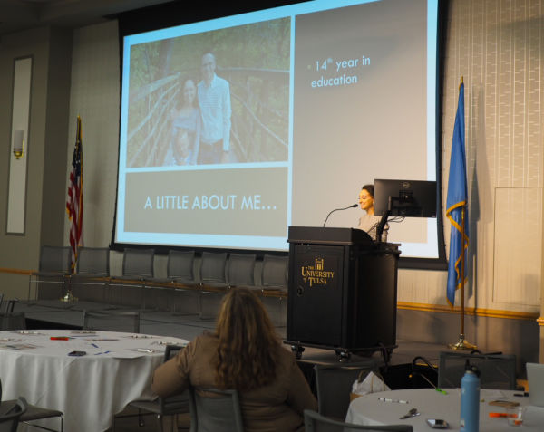
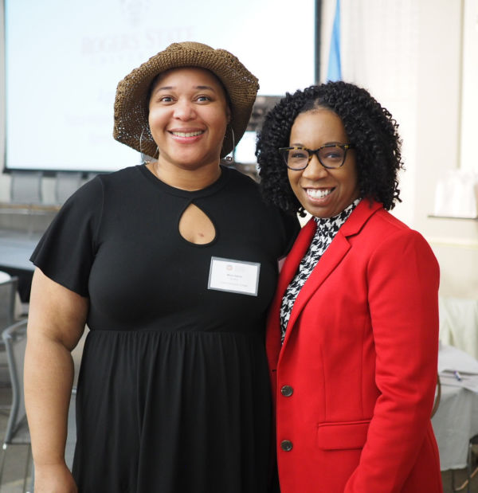
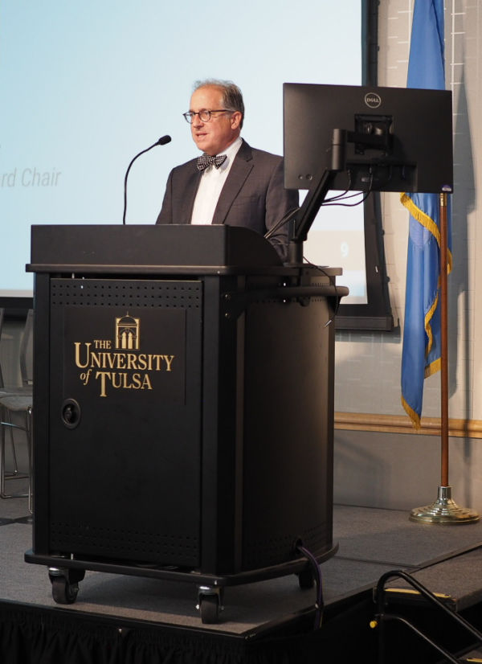
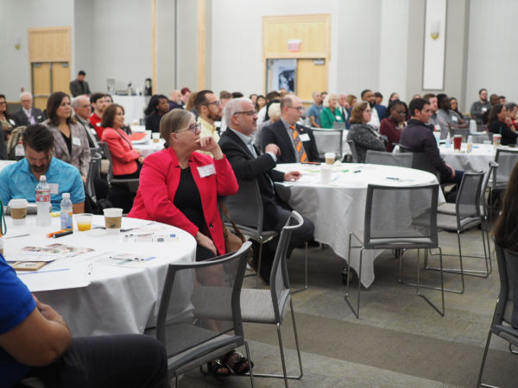
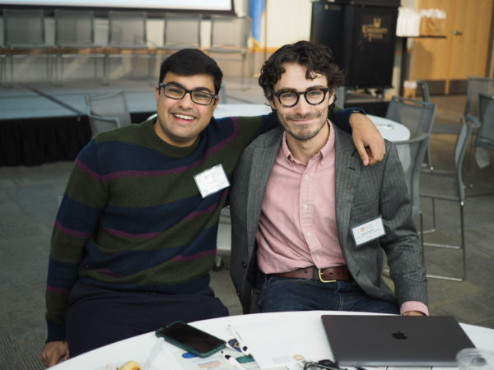
Collaboration is Critical
Notes:
Sarah

Slide 17
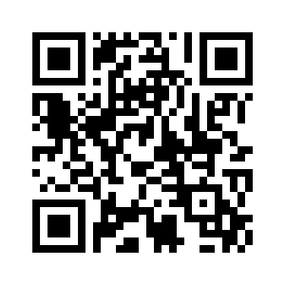
Follow us on Social Media!
Website:
www.tulsahighered.com
Want to receive our monthly newsletter? Sign up here!
@TulsaHigherEducationConsortium
@HigherTulsa
@tulsahighered
@TulsaHigherEducationConsortium

Slide 18
Questions?
Contact: llatta@tulsahighered.com
swyatt@tulsahighered.com
brandon.miller10@tulsacc.edu

