Slide 1


Slide 2

Ensuring Transfer Success Through Intentional Student Planning, Exploration, and Collaboration:
Tulsa Community College Case Study

Slide 3
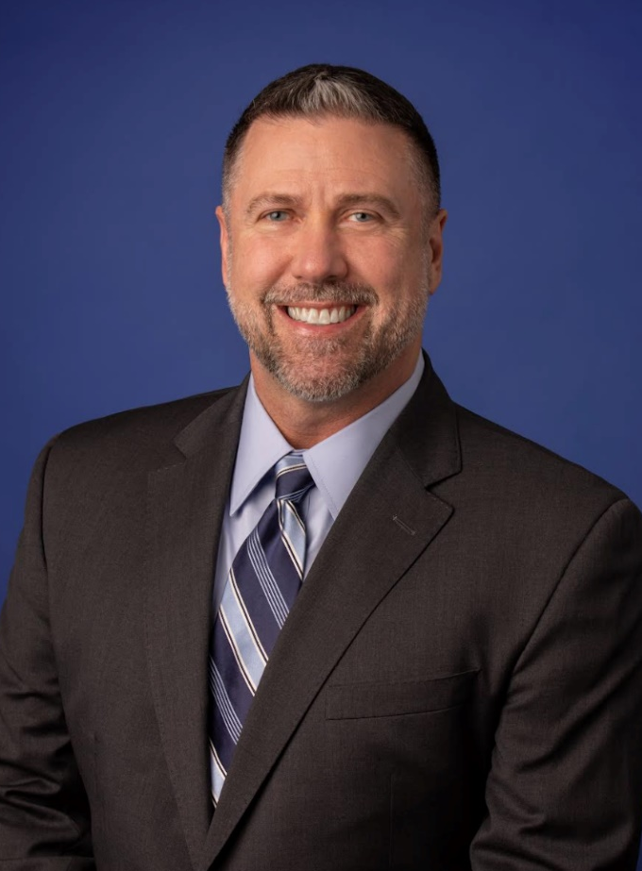
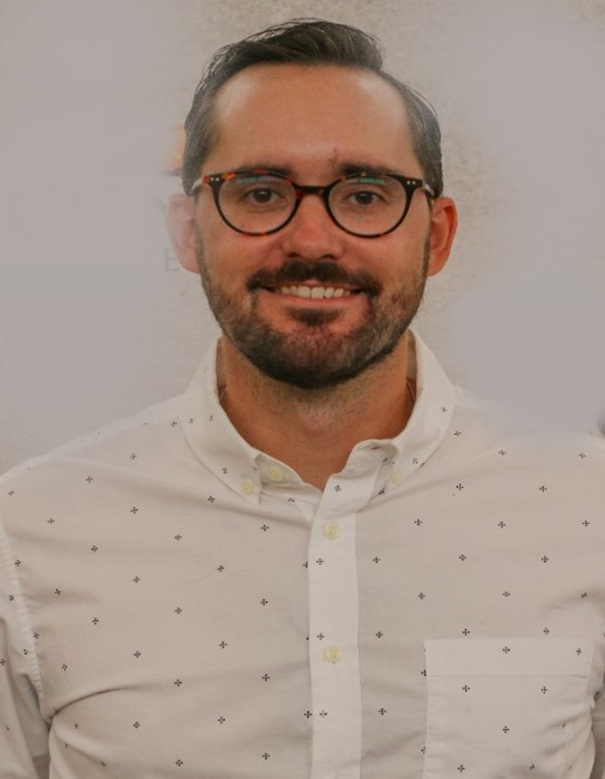
Presenters
Dr. Brandon B.A. Miller
John L. Norwood II
Director of University Transfer
Tulsa Community College
University Transfer Coordinator
Tulsa Community College

Slide 4

University Transfer Planning & Resources:
  Transfer Research Worksheet, Transfer Map, University Transfer Checklist
  Degree Pathways Search Tool
  Information provided by regional universities.
Transfer Centers:
  Transfer Centers are located on all 4 campuses.
  Check the Transfer Center Schedule to connect with university representatives in person or online.
  Transfer Centers have flyers and resources available for students from regional universities.
  Connect with a Transfer University survey
Transfer Exploration Events (student focused):
  University Days, Transfer Tuesdays, RN to BSN Transfer Fair, and more!
Transfer Thursdays (Staff/Faculty Professional Development Opportunity)
College Park

Slide 5
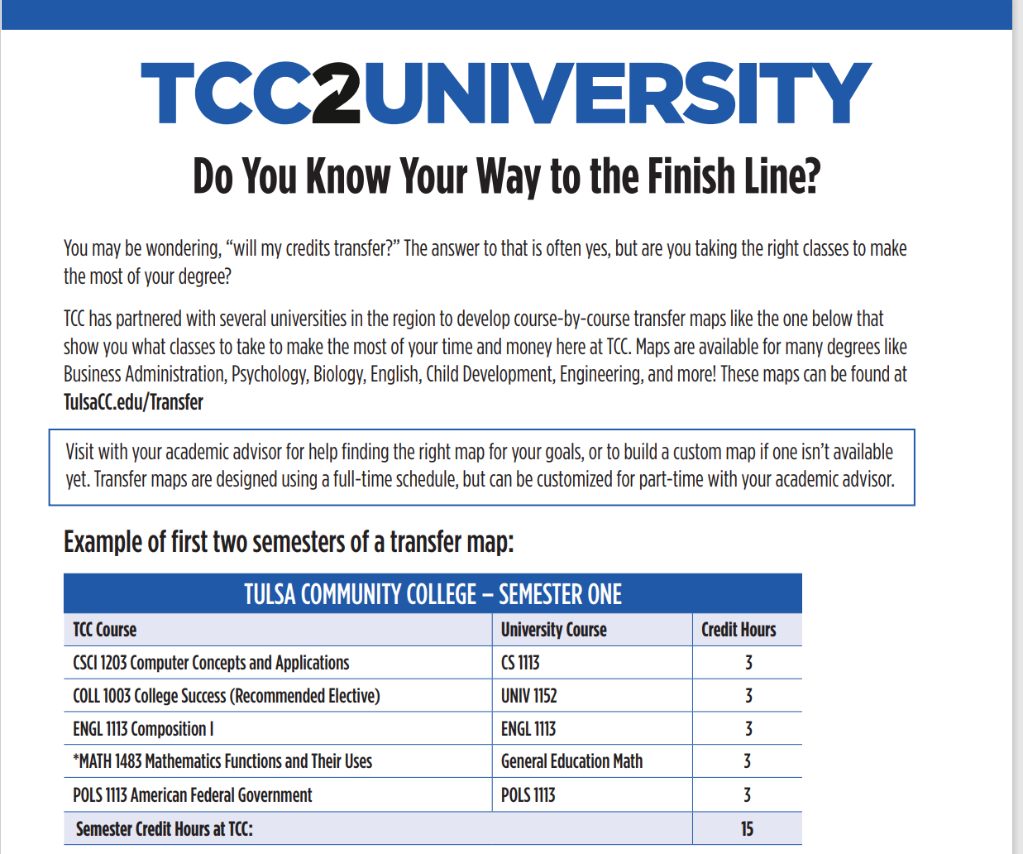
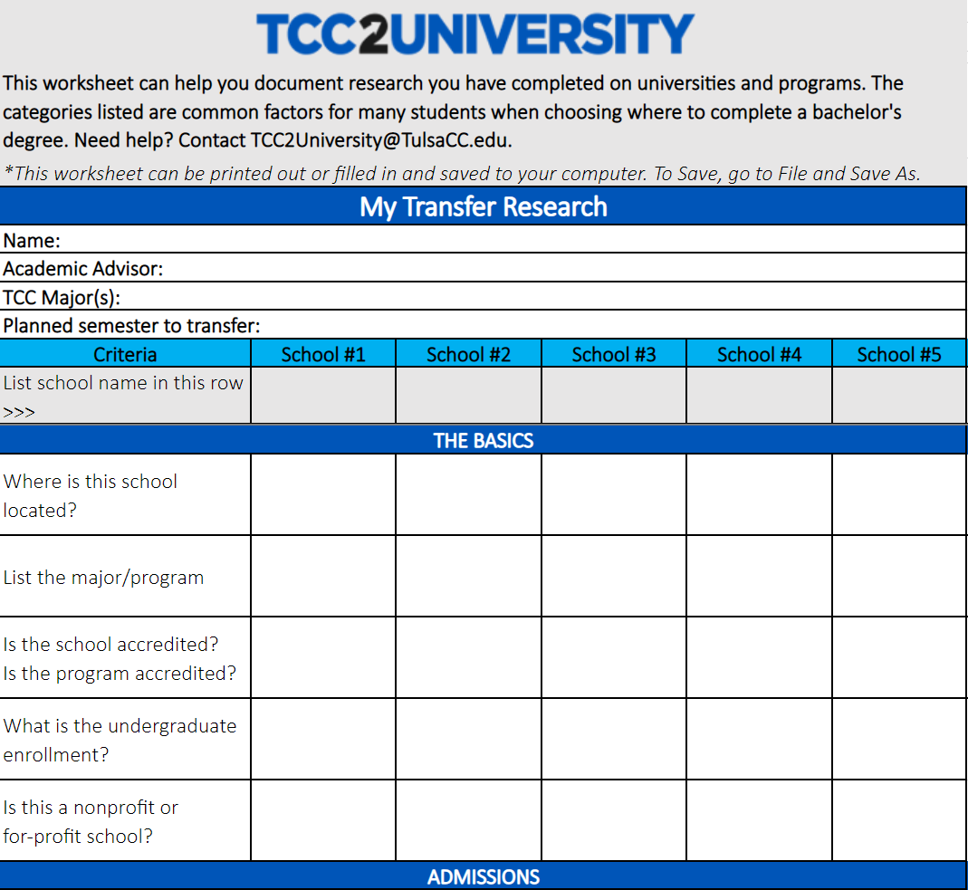
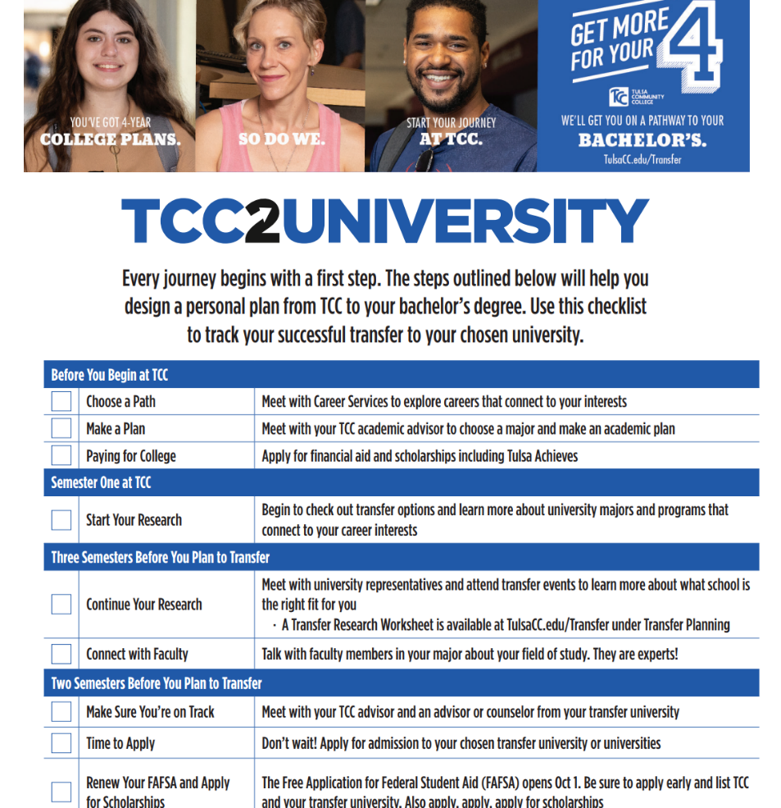

Slide 6
TCC currently has over 100 bachelor’s degree pathways to over 10 universities, with additional pathways added regularly. 100% of AA & AS degrees will be tied to a transfer map by the end of 2023-2024 academic year.
Accounting
Aerospace
American Studies
Art
ASL Interpreter
Aviation Management
Biology
Business
Chemistry
Computer Science
Communication Disorders
Criminal Justice
Economics
Education
Engineering
Energy Management
Entrepreneurship
Finance
Financial Planning
Financial Management
Graphic Design
Health Education/Wellness
History
Hospitality and Tourism
Human Resources
Human Relations
International Business
Information Systems
Liberal Arts
Management
Marketing
Math
Music
Nutrition
Physics
Political Science
Psychology
Pre-Physical Therapy
Pre-Law
Public Health
Sociology
Social Work
Sports Management
Supply Chain
Theatre

Slide 7

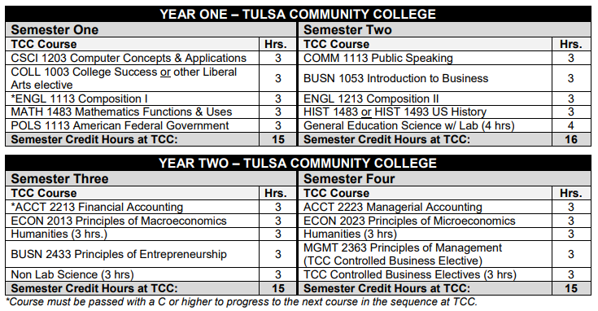
Business Transfer Map Example

Slide 8

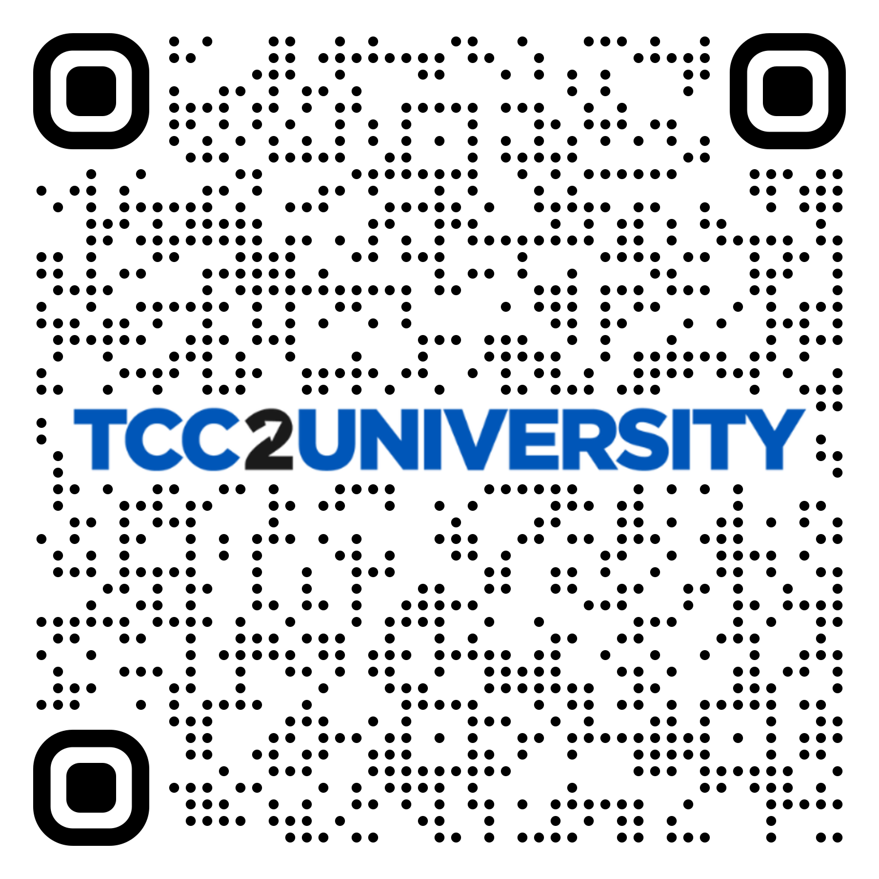

Visit with Universities
In person or virtually
On Campus Locations
Dedicated for 1 on 1 meetings
Printed material
Transfer Center Schedules
Tulsacc.edu/TransferCenter
Posted to The Week for Students in your email
Connect using a Transfer University form
Get connected with your choice university
Notes:
Early connection with transfer planning and universities is critical! Jessica will cover.

Slide 9

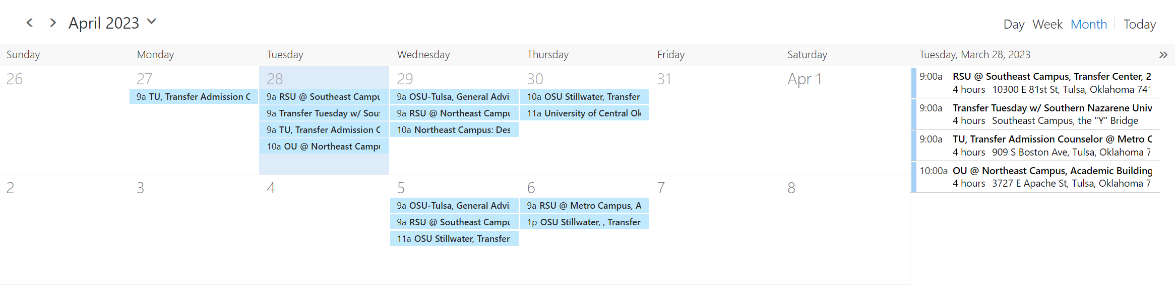
www.TulsaCC.edu/transfercenter

Slide 10
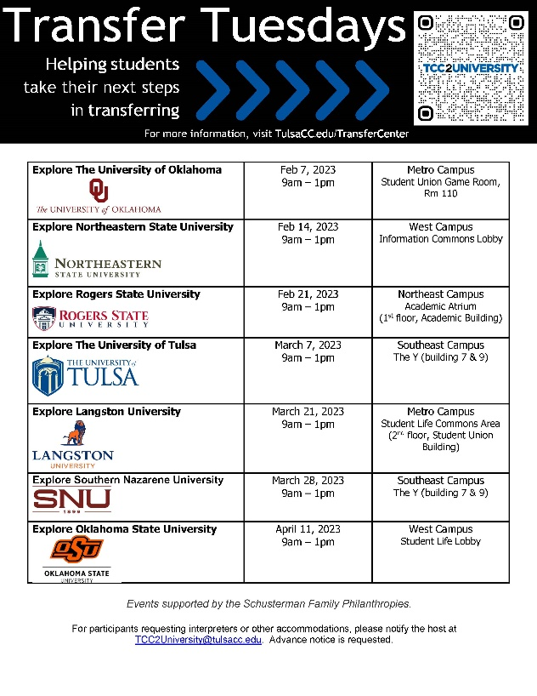

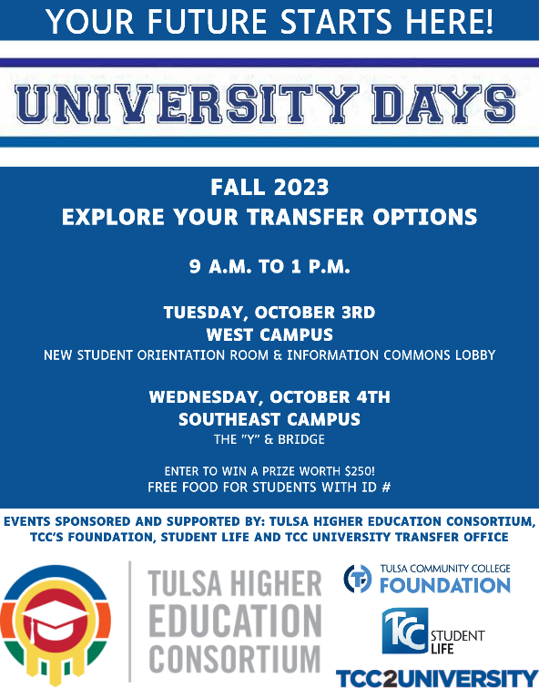

Transfer Events
Visited by over 300 students this fall!
Full schedule of Transfer Events @ www.TulsaCC.edu/transfercenter

Slide 11

Transfer Thursdays: Staff/Faculty Professional Development Opportunity
  University representatives will talk about admission details/information, academic programs, scholarship opportunities, and campus life
Date | Time | University Partner | Zoom link
02/02/2023 | 9am – 10am | Tulsa Higher Education Consortium | https://zoom.us/j/97776702505
02/16/2023 | 9am – 10am | Southern Nazarene University | https://zoom.us/j/93088973676
02/23/2023 | 9am – 10am | Oral Roberts University | https://zoom.us/j/91409528224
03/02/2023 | 9am – 10am | Northeastern State University Tahlequah | https://zoom.us/j/94831750784
03/09/2023 | 9am – 10am | University of Oklahoma Tulsa | https://zoom.us/j/95339274626
03/23/2023 | 9am – 10am | The University of Tulsa | https://zoom.us/j/93336536473
03/30/2023 | 9am – 10am | Rogers State University | https://zoom.us/j/97759036329
04/06/2023 | 9am – 10am | University of Central Oklahoma | https://zoom.us/j/99487870807

Slide 12




tulsahigheredu.com

Slide 13


Two Colleges. One Campus.
Two Colleges. One Campus.

Slide 14


Slide 15

General Information:
Students can take all their classes for a bachelor’s degree at one location
Pay same tuition and fees as other TCC students and have access to the same financial aid options, including Tulsa Achieves
Receive all the same benefits as other TCC students plus exclusive benefits typically reserved only for OSU students
A consistent course schedule to help maintain a steady work-school-life balance
Exclusive scholarships available only for College Park students
Easily accessible academic support and student resources

Slide 16
By the numbers:
First cohort of graduated students spring 2023 – 11
Currently 43 students in College Park Program.
42% increase in program participation from 2022-23 to 2023-24

Slide 17

TCC Degree Options:
AS Business Administration
AA Psychology
AS Mechanical Engineering (New program 2023-2024)

Slide 18
OSU Degree Options:
Business Track Options:
  Accounting
  General Business
  Management
  Management Information Systems
  Marketing
  Finance
Psychology Track Options:
  Human Development and Family Science: Child and Family Services
  Organizational Leadership
  Psychology
  Public Safety
Engineering Track - Mechanical Engineering

Slide 19
FALL 2023: ENGINEERING Path
Background:
Grant-Funded addition to the existing CP degree pathway programs.
TCC/OSU partnership included in multi-level, research based strategy presented by the Tulsa Community Foundation + Tulsa Innovation Labs
Goal is to fill the widening skills gap in the local Engineering sector
Partners in efforts from educational sector, workforce alliances, State –level programs and non-profit entities
FALL 2023: ENGINEERING Path
Notes:
Grant-Funded addition to the existing CP degree pathway programs. TCC/OSU partnership included in multi-level, research based strategy presented by the Tulsa Community Foundation + Tulsa Innovation Labs seeking to fill the broadening skills gap in the local Engineering sector by employing efforts from educational sector, workforce alliances, State –level programs and non-profit entities.

Slide 20

Focus:
Increase Degree Completion Rates in Underrepresented Communities
Overcome Socio-Economic Barriers with Affordable Education Options
Meet Student Needs by Offering Wrap-Around Services via TCC/OSU Student Services Departments and Community-Based Organizations
Increase Retention Rates via Individualized Student Support, Small Class Sizes and an Engaging College Campus Experience
FALL 2023: ENGINEERING Path
Notes:
Grant-Funded addition to the existing CP degree pathway programs. TCC/OSU partnership included in multi-level, research based strategy presented by the Tulsa Community Foundation + Tulsa Innovation Labs seeking to fill the broadening skills gap in the local Engineering sector by employing efforts from educational sector, workforce alliances, State –level programs and non-profit entities.

Slide 21
FALL 2023: ENGINEERING Path
Program Highlights:
Two Program Pathways
Internship + Research Opportunities
A.S. Mechanical Engineering from TCC + B.S. Mechanical Engineering from OSU
Students Complete Program in 4 to 4.5 Yrs
Afternoon and Evening Class Offerings
Targeted Engagement Opportunities (Workshops, Events, Tours, Career Fairs, Etc)
Notes:
Grant-Funded addition to the existing CP degree pathway programs. TCC/OSU partnership included in multi-level, research based strategy presented by the Tulsa Community Foundation + Tulsa Innovation Labs seeking to fill the broadening skills gap in the local Engineering sector by employing efforts from educational sector, workforce alliances, State –level programs and non-profit entities.

Slide 22
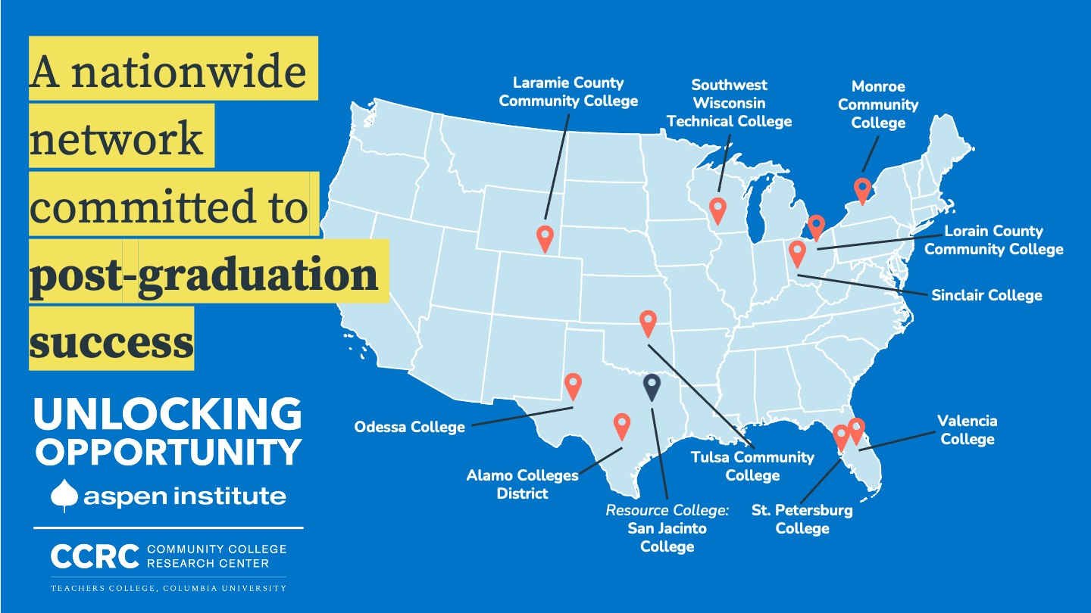
The Aspen Institute College Excellence Program

Slide 23
Program’s Overarching Goal
Thousands more community college students, including students of color and those from lower-income backgrounds, entering and completing programs that lead directly to jobs that pay a family-sustaining wage or to efficient and effective completion of a bachelor’s degree.

Slide 24
Future Transfer Initiatives
Align transfer degree with in-demand bachelor degrees
Create a soft hand-off bridge to 4-year transfer partner institutions
Strengthen transfer advising
Capture and update transfer intent
Develop robust transfer guides that highlight student success and career outcomes data at transfer partner institutions
Strengthen transfer partnerships with transfer institutions, especially those that offer similar support services

Slide 25
Thank you,
Any Questions?
CONNECT WITH US!
Brandon B. A. Miller, Ed. D., Director of University Transfer
brandon.miller10@tulsacc.edu
  John Norwood, University Transfer Coordinator-College Park
john.norwood1@tulsacc.edu
TulsaCC.edu/Transfer
TCC2University@TulsaCC.edu
918.595.7774

