Slide 1
Statewide Transfer Audit & Policy
Dr. Stephanie Baird sbaird@osrhe.edu
Associate Vice Chancellor for Research, Planning, & Evaluation
Oklahoma State Regents for Higher Education
Dr. Johnnie-Margaret McConnell johnniemargaret@ou.edu
Director of Transfer Student Success
University of Oklahoma

Slide 2
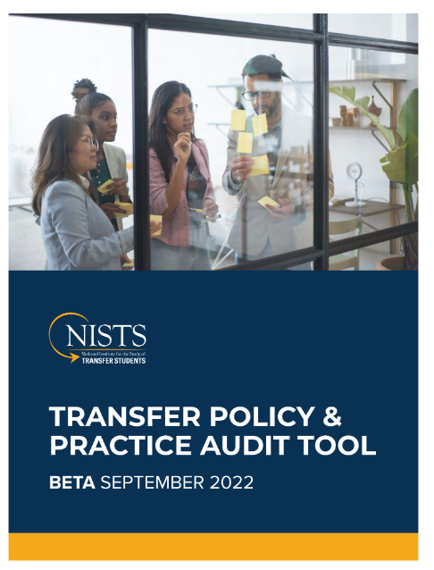
OSRHE Request
Gather institutions current practices and procedures around undergraduate transfers.
Asked to identify and research potential audit tools.
Reviewed existing transfer surveys from the Aspen Institute and National Institute for the Study of Transfer Students.
Recommended NISTS Transfer Policy & Practice Audit Tool as it is focused on transfer friendliness.
Notes:
Introduction Johnnie-Margaret
Use fly in bullets to walk audience through the context.
Make verbal note below…
We do recognize that some of you have recently completed an intensive self-study as part of the Tulsa Higher Education Consortium. This was taken into consideration when selecting our survey tool. We believe, and encourage, you to use already collected data to complete this online survey.

Slide 3
NISTS Transfer Policy & Practice Audit Tool
Part A: Institutional Policies & Practices Section 1: Institutional Strategy Section 2: Goals and Measurement Section 3: Partnering with Sending and Receiving Institutions Section 4: Communications Part B: Student-Facing Delivery & Supports Section 1: Admissions, Advising, Orientation, & Registration Section 2: Evaluating, Awarding & Applying Credits Section 3: Transfer Student Engagement & Supports
Notes:
Johnnie-Margaret
Survey consists of two parts

Slide 4
Data Collection Process
Notifying all Oklahoma institutions via email this month.
COI (via Stephanie Beauchamp - AVC for Academic Affairs)
Collecting institutional information is a full campus endeavor.
Work with campus stakeholders to complete both parts.
Submit one institutional audit through Google Docs Form.
Deadline is April 1, 2023.
Notes:
Stephanie

