Slide 1


Slide 2
Course Equivalency Project (CEP)
Angel Icenhour
Director of Concurrent Enrollment Programs

Slide 3
Course Equivalency Project
What is the CEP?
A database containing faculty-generated course equivalencies for
Oklahoma institutions.
48 disciplines
8,072 courses
Who Participates?
Public institutions and HLC accredited private institutions.
How does the CEP Benefit Students?
Gives students the ability to see where their courses will transfer or where they can take a specific course to bring back to their home institution. Ultimately, saving them time and money on their journey to degree completion.
Visit the State Regents’ website for more information on the CEP.
Notes:
AVP Round I, Faculty Round, AVP Round II.
Common Course Descriptions must match by 75%.
Student Learning Outcomes must match by 100% (developed at a minimum).

Slide 4
Course equivalencies are tables of courses that are transferable among Oklahoma public colleges and institutions (as well as some private institutions). Each table displays equivalent courses at each college and university and is organized by academic discipline, such as biology or history.

Slide 5

COMMON COURSE DESCRIPTION AND STUDENT LEARNING OUTCOMES
COMMON COURSE DESCRIPTION
STUDENT LEARNING OUTCOMES
A common course description is a broad overview of the course.
Student learning outcomes are statements that specify what students will know, be able to do or be able to demonstrate when they have completed the course.

Slide 6

EQUIVALENCY REQUIREMENTS
  Common course descriptions must overlap by 75% or more to determine equivalency.
  Added in 2017 -
  All student learning outcomes are required to be on each participating institutions syllabi. These outcomes are developed by faculty and are developed at a minimum (3-5).

Slide 7
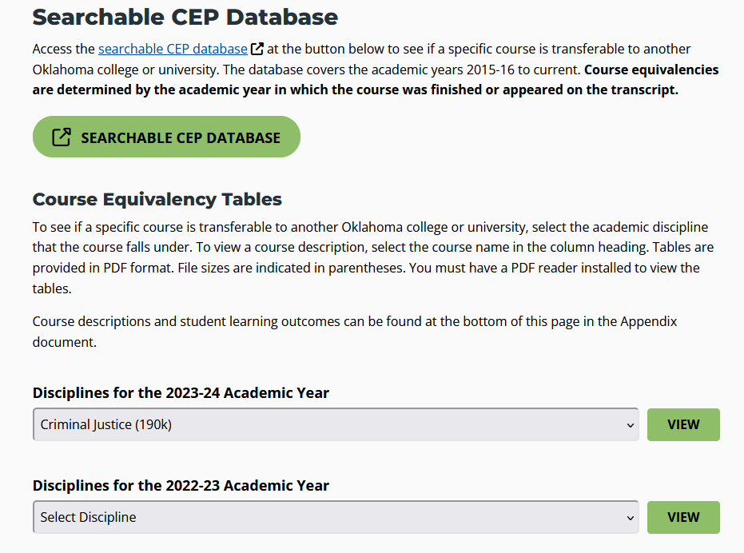
Equivalencies are based on academic year

Slide 8
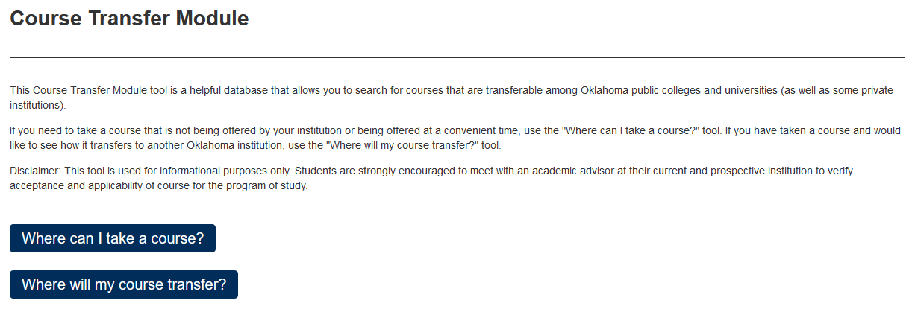
Searchable CEP Module

Slide 9
  If your course is listed under a category, you are obligated to accept every other course in that category as equivalent to yours and every other institution is under this obligation with your course.

Slide 10
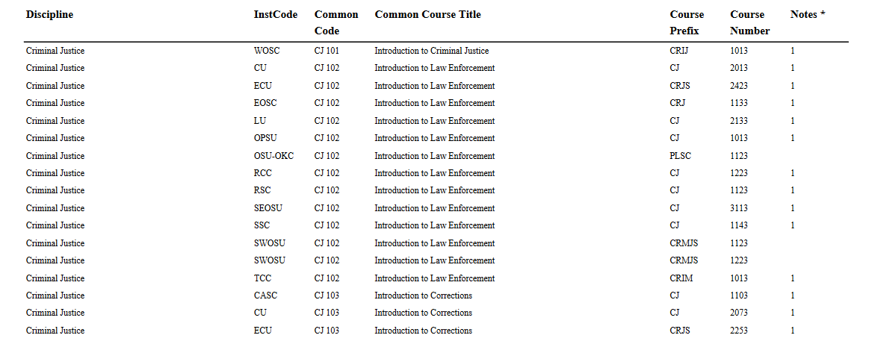
CEP – Criminal Justice (2023-2024)

Slide 11



INSTITUTION REVIEW
FACULTY REVIEW
INSTITUTION 2ND REVIEW
COI APPROVAL
STATE REGENTS APPROVAL
MATRIX POSTED ONLINE
CEP CYCLE OVERVIEW:
WE ARE HERE!
MAY - AUG
SEPT
OCT - DEC
FEB
MARCH
APRIL

Slide 12
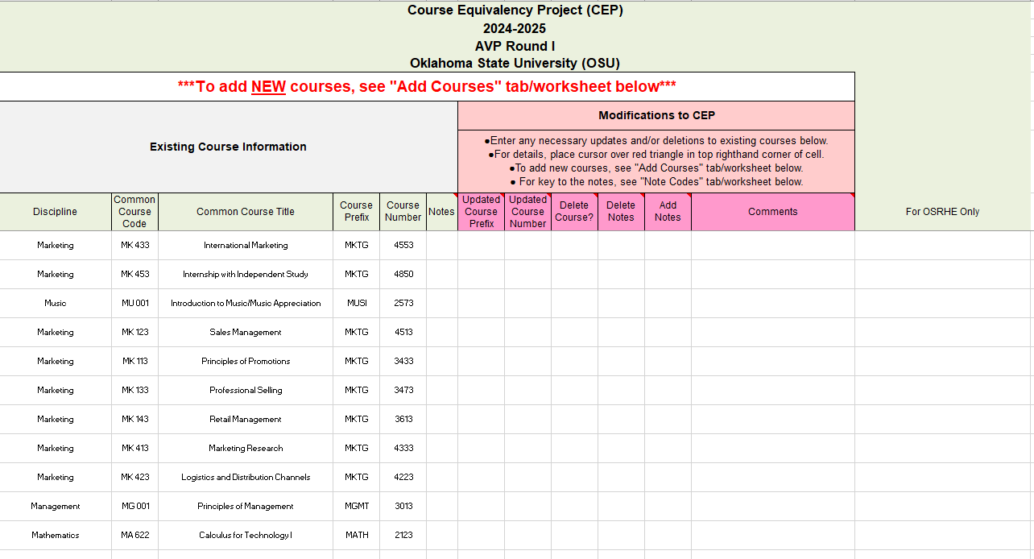
ACADEMIC VICE
PRESIDENT
ROUND I & II

Slide 13
FACULTY ROUND
  12 Disciplines
  COI Facilitator/Faculty Chair
  Objectives
    Review current content
    Develop SLOs
    Review Syllabi for NEW Course Additions
2023 Faculty Meeting - 313
American Indian Studies | American Sign Language | Chemistry
Business Communication | Biological Science | Criminal Justice
Physical Science | Economics | German
Theatre | English | Humanities

Slide 14
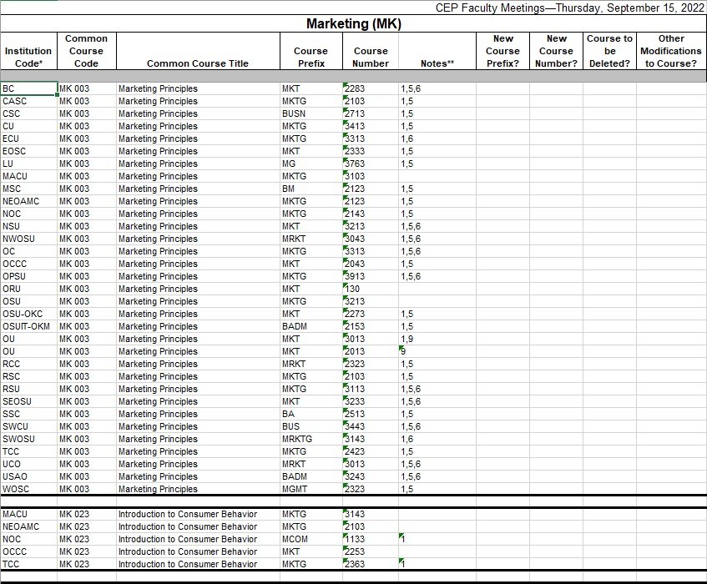
Faculty Meeting
Sheet (create version)

Slide 15
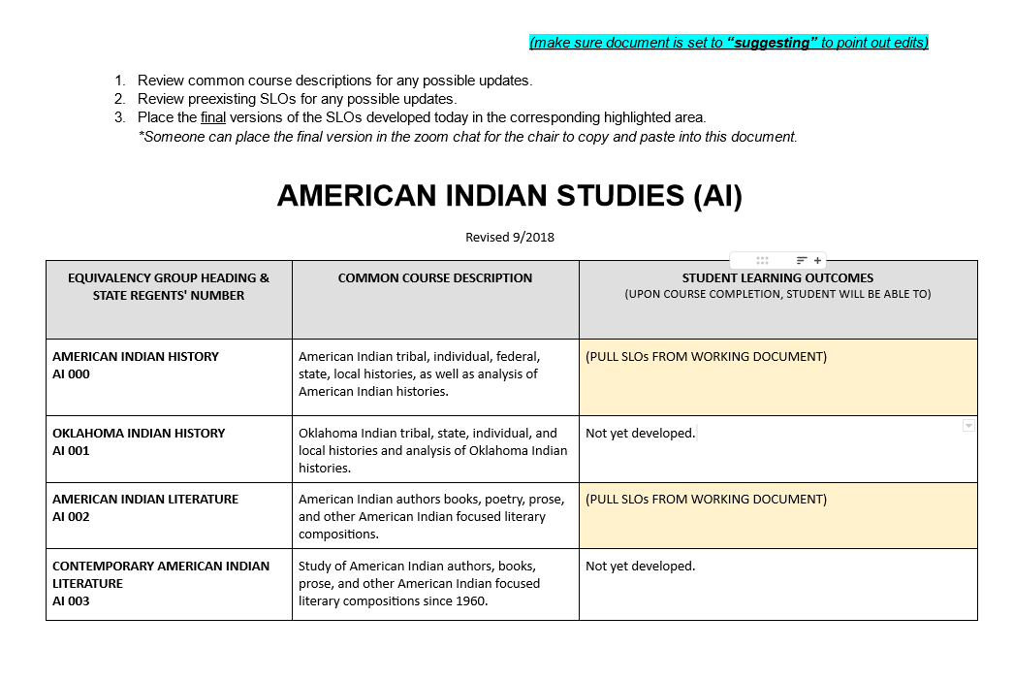
Common Course Description and SLOs (modifications and new)
https://docs.google.com/forms/d/1nDYLnVGKFZBin-RXGDXZzM7opAWZjcdTzvArur7Zkt8/edit

Slide 16
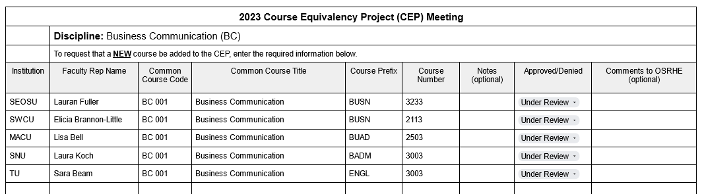
New Course Additions

Slide 17
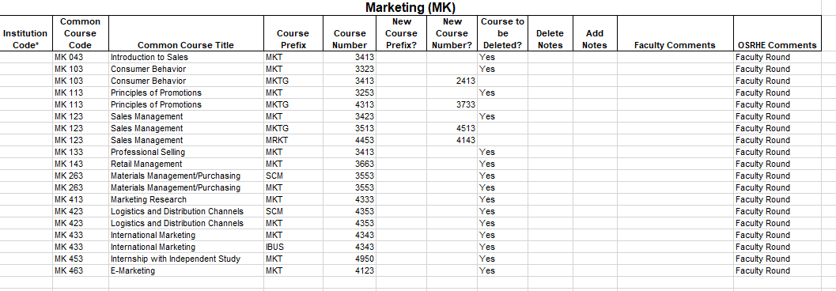
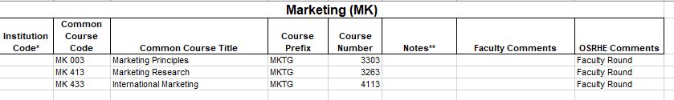
Faculty Meeting Sheet (Import version)

Slide 18
NOTES
If a student transfers a lower division (1000-2000) course to an institution that offers the course at the upper division level (3000-4000), the lower division course will transfer as equivalent in content but not as upper division hours.
To receive full transfer credit, all courses in the sequence must be completed. Single courses will transfer at the discretion of the receiving institution. (Students should contact their institution in order to determine what additional course(s) is/are required for full transfer credit.)
If possible, students taking courses presented in sequence (I.e., I and II) should try to complete both courses at the same institution.
The degree requirements for history include approximately 15 to 18 semester hours of lower division work and from 21 to 36 hours of upper-division work.
This course requires a lab component be successfully completed simultaneously in order to receive full transfer credits. (2010-2011)
If course prerequisites are not equivalent, the receiving department reserves the right to require the course to be taken at the 3000 level.
No required course sequence is to be inferred from the course numbering.
At least 75% of the lab component must be face-to-face instruction (as opposed to online instruction). If not, such courses will transfer at the discretion of the receiving institution.
Any lower division course will equate to a comparable lower division course should such a course exist.
TBD-to be determined-means the course is currently being created at the institution and does not yet have an assigned course number/prefix; however, the course has been pre-approved as a course equivalent in this category by the appropriate faculty group.
Placement exam required in order to receive full transfer credits in the major

Slide 19



Ms. Angel Icenhour
Director of Concurrent Enrollment Programs
Oklahoma State Regents for Higher Education
aicenhour@osrhe.edu
SCAN ME!

