Slide 1


Slide 2
Student and Credit Mobility:
Key Topics in Research and Practice
Emily Tichenor
Ithaka S+R, Educational Transformation
Program Manager, Articulation of Credit Transfer Project
October 17, 2023
Oklahoma Statewide Transfer Student Success Conference

Slide 3
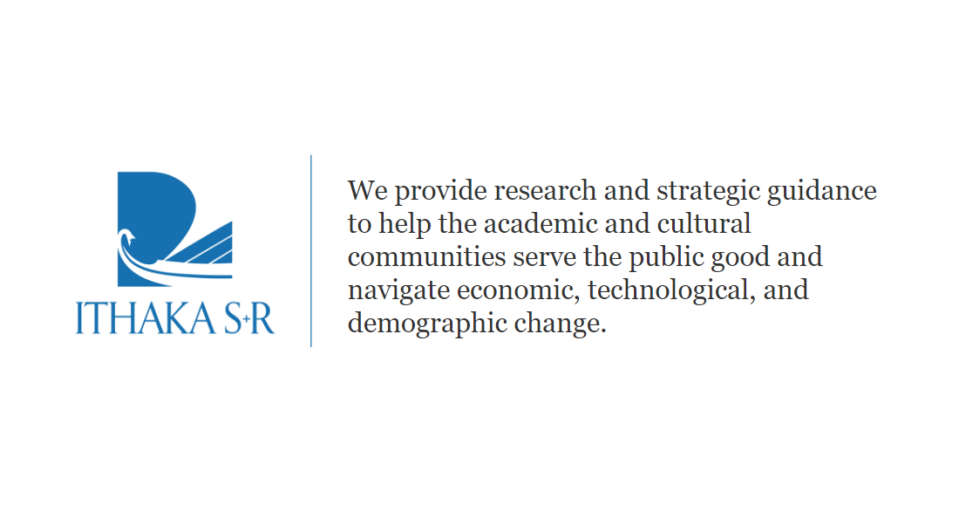
3
Holistic Credit Mobility
October 13, 2023

Slide 4


Articulation of Credit Transfer (ACT) Project
Core Principle: Make all information about transferring to different colleges (particularly credit transfer) completely public and easily accessible.

Slide 5



Our Purpose Today
Understand the credit mobility landscape
Explore key topics in the national conversation around transfer and credit mobility
Why? So that all students can reach their academic and career goals efficiently and affordably.

Slide 6
Key Facts and Figures
45 percent of Associate degree holders and 67 percent of Bachelor degree holders have transcripts from multiple institutions
Dual enrolled high school students now account for over 16 percent of community college students nationwide
Over 40 million Americans now fall into the category of “some college, no credential”
80% of community college students indicate a bachelor’s degree is their goal, but only 32% who entered in Fall 2015 transferred within 6 years to a 4-year institution
1/3 of veterans hold a certificate or certification, but no additional education
While a majority of institutions offer credit for prior learning, only 11 percent of adults reported earning CPL in recent studies

Slide 7

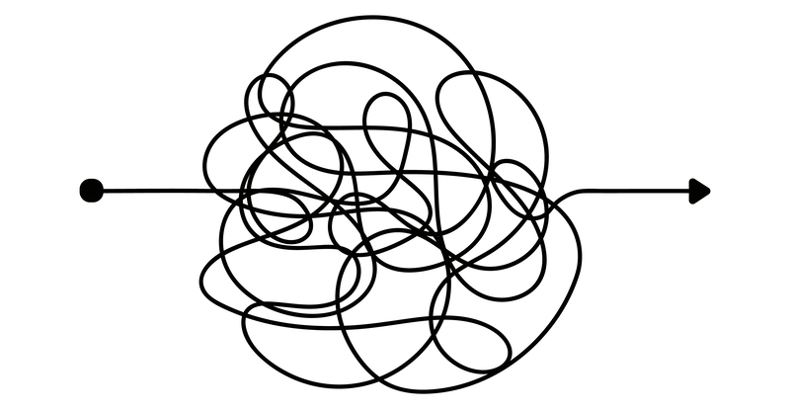

Modern, Mobile, Multidirectional

Slide 8
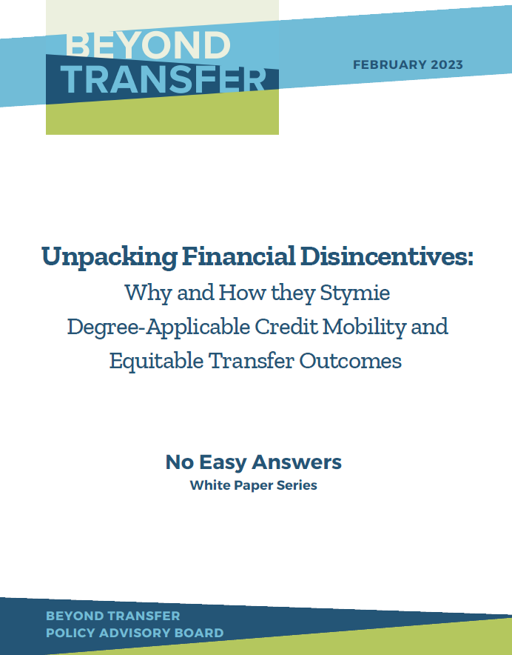
An Uncomfortable Reality
The $ and ¢

Slide 9
The (50) State(s) of Transfer Data
New analysis conducted by the Aspen Institute College Excellence Program and the Community College Research Center
“About 450,000 students transfer each year, but far too many others get waylaid by broken systems. To fix the problem, we have to know what’s causing it. However, the kinds of data needed to fix transfer are nonexistent or severely lacking in most states.”
    -Alex Anacki and Jessie Steiger, Inside Higher Ed, May 11, 2023
In 31 states there are no publicly reported data on transfer student outcomes and experiences (e.g. transfer rates, graduation rates, time to degree and credit accumulation)

Slide 10
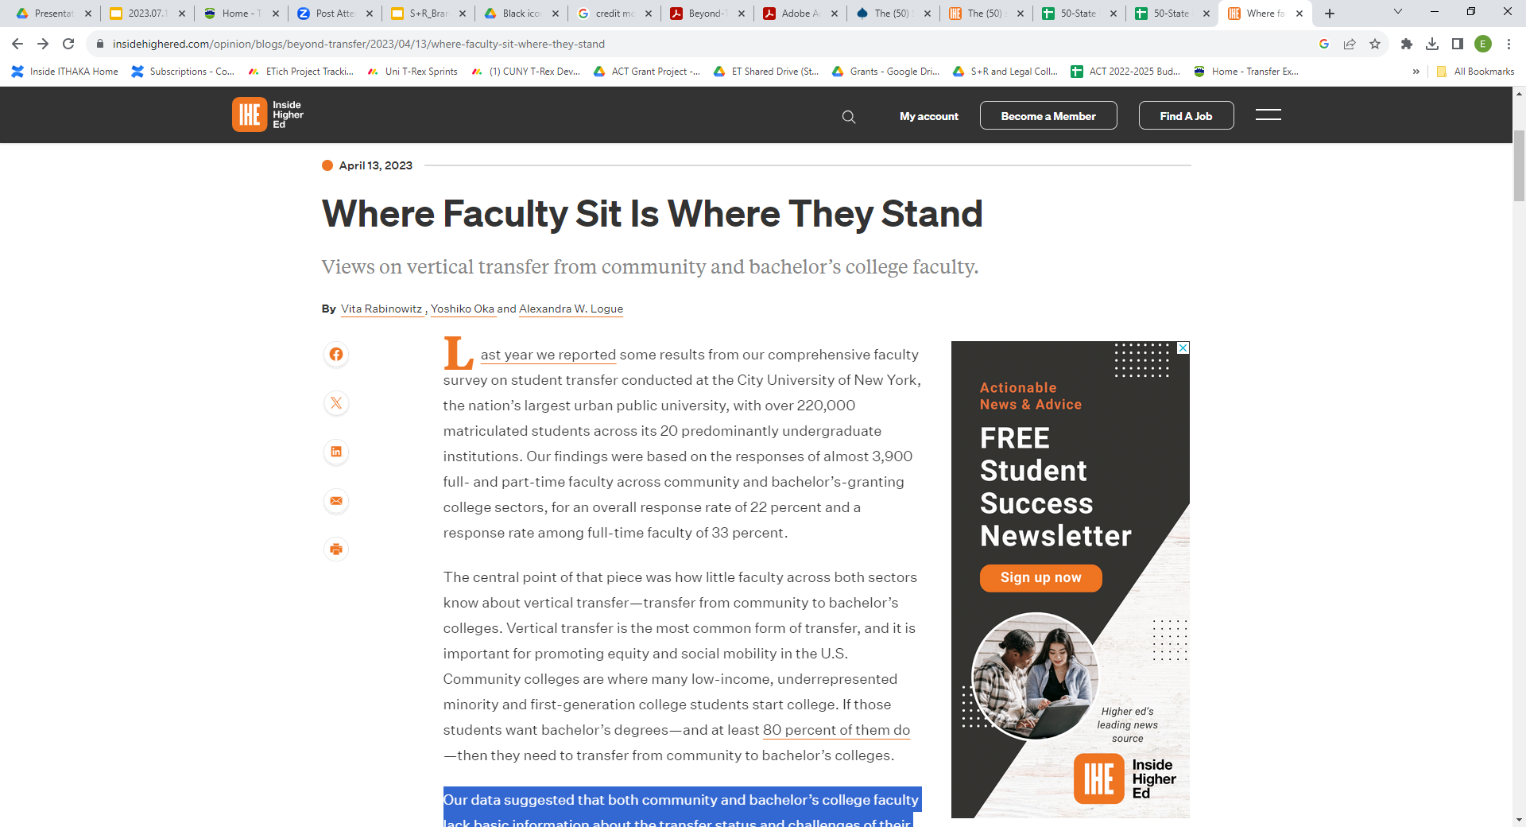
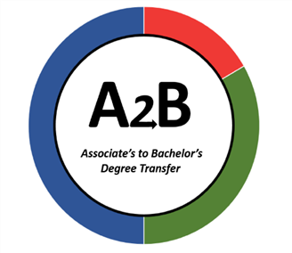
“Our data suggested that both community and bachelor’s college faculty lack basic information about the transfer status and challenges of their students, the transfer policies and practices that exist in their colleges and across the university, and the implications of those policies and practices for transfer student outcomes.”
-Inside Higher Ed, Beyond Transfer

Slide 11
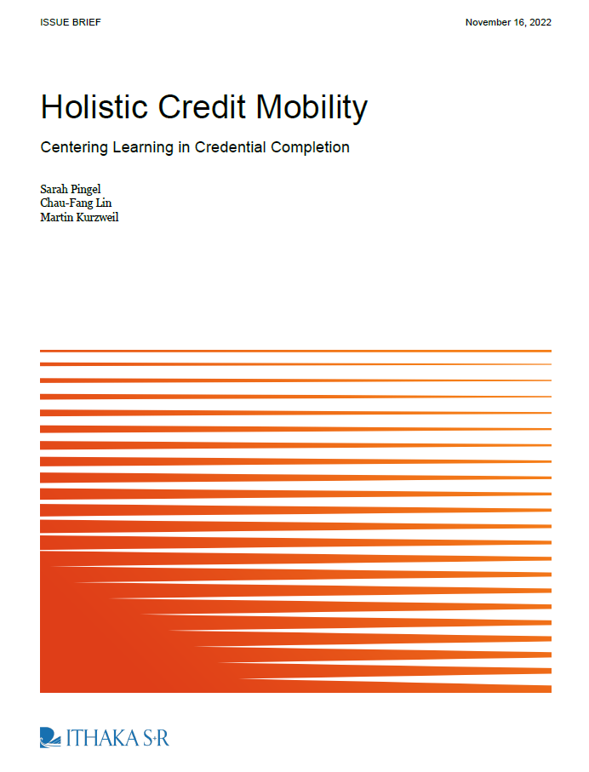
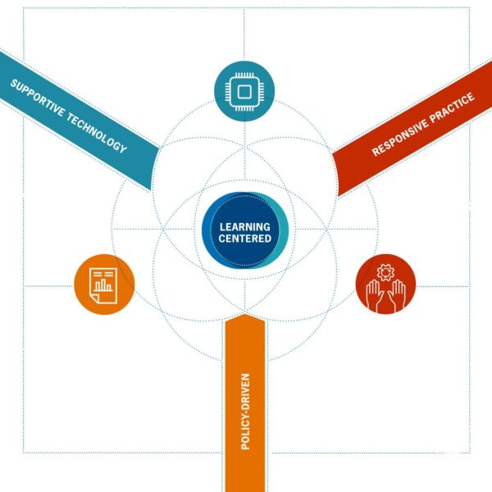

Slide 12

Relationships Matter
“Lost in the Shuffle”: How Relationships and Personalized Advisement Shape Transfer Aspirations and Outcomes for Community College Students
-Maggie P. Fay, Shanna Smith Jaggars & Negar Farakish
Community College Review July 2022
However… student surveys tell us far too many students are not aware of and not accessing support services on campus.

Slide 13
Final Questions
How can we adopt policies and processes that support mobile learners?
What can we do to overcome financial disincentives at an institution and state level?
How can we further increase the transparency of course and experience credit equivalencies so students can explorer their options?
What do we need to know about mobile students in our state?
How can we support staff, advisors, and faculty serving mobile students?

Slide 14
Thank you! Let’s Stay Connected.
Emily Tichenor
Program Manager - Ithaka S+R
Emily.Tichenor@Ithaka.org linkedin.com/in/eatichenor https://sr.ithaka.org/blog/

Slide 15
References
Patel, P., & Kurzweil, M. (2023, February 16). Opening the black box of credit transfer to everyone - Ithaka S+R. Ithaka S+R. https://sr.ithaka.org/blog/opening-the-black-box-of-credit-transfer-to-everyone/
Doug Shapiro, Afet Dundar, Phoebe Khasaiala Wakhungu, Xin Yuan, Angel Nathan, and Youngsik Hwang, Time to Degree: A National View of the Time Enrolled and Elapsed for Associate and Bachelor’s Degree Earners (Report no. 11), Herndon, VA: National Student Clearinghouse Research Center, September 2016, https://nscresearchcenter.org/wp-content/uploads/SignatureReport11.pdf.
Current Term Enrollment Estimates | National Student Clearinghouse Research Center. (May 24, 2023). https://nscresearchcenter.org/wp-content/uploads/CTEE_Report_Spring_2023.pdf
Causey, J., Gardner, A., Pevitz, A., Ryu, M., and Shapiro, D. (April 2023), Some College, No Credential Student Outcomes, Annual Progress Report – Academic Year 2021/22, Herndon, VA: National Student Clearinghouse Research Center. https://nscresearchcenter.org/wp-content/uploads/SCNCReport2023.pdf
“Community College FAQS.” Community College Research Center. https://ccrc.tc.columbia.edu/community-college-faqs.html.
Veterans Without Degrees: The Benefits and Opportunities of Certificates and Certifications. Strada Education Network, Gallup, and Lumina Foundation. October 2019. https://www.luminafoundation.org/resource/veterans-without-degrees/
The PLA Boost: Results from a 72-Institution Targeted Study of Prior Learning Assessment and Adult Student Outcomes. Revised. Klein-Collins, Rebecca; Taylor, Jason; Bishop, Carianne; Bransberger, Peace; Lane, Patrick; Leibrandt, Sarah. Council for Adult and Experiential Learning. https://www.cael.org/hubfs/PLA%20Boost%20Report%20CAEL%20WICHE%20-%20October%202020.pdf

Slide 16
References
Couturier, L. (2023) Unpacking financial disincentives: Why and how they stymie degree-applicable credit mobility and equitable transfer outcomes. Beyond Transfer Policy Advisory Board. SOVA.2023. https://sova.org/wp-content/uploads/2023/02/Beyond-Transfer-Unpacking-Financial-Disincentives-Feb-2023.pdf
The Aspen Institute College Excellence Program. (2023, May 18). The (50) State(s) of Transfer Data - The Aspen Institute College Excellence Program. https://highered.aspeninstitute.org/press/the-50-states-of-transfer-data/
Rabinowitz, V., Logue, A. W., & Oka, Y. (2023). Where faculty sit is where they stand. Inside Higher Ed | Higher Education News, Events and Jobs. https://www.insidehighered.com/opinion/blogs/beyond-transfer/2023/04/13/where-faculty-sit-where-they-stand
Kurzweil, M., Pingel, S., & Lin, C.-F. (2022). Holistic Credit Mobility. Ithaka S+R. https://sr.ithaka.org/publications/holistic-credit-mobility/
Fay, M. P., Jaggars, S. S., & Farakish, N. (2022). “Lost in the Shuffle”: How relationships and personalized advisement shape transfer aspirations and outcomes for community college students. Community College Review, 50(4), 366–390. https://doi.org/10.1177/00915521221111468
Fay, M. P. (2023, March 14). Relationships matter for transfer outcomes (and everything else). Community College Research Center. https://ccrc.tc.columbia.edu/easyblog/relationships-matter-for-transfer-outcomes.html
Mowreader, A. (2023). Survey: College students don’t know about support services. Inside Higher Ed | Higher Education News, Events and Jobs. https://www.insidehighered.com/news/student-success/college-experience/2023/07/20/survey-college-students-dont-know-about-support

